Slide 1
Regulatory Flexibility Committee
Competitive Procurement
September 18th
Joe Kerecman
Director Government and Regulatory Affairs
Joe.Kerecman@calpine.com

Slide 2
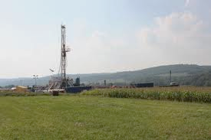

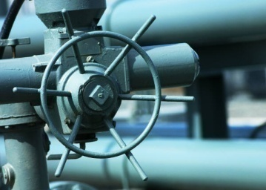
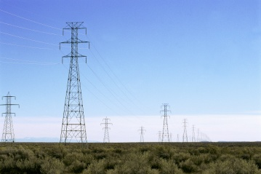
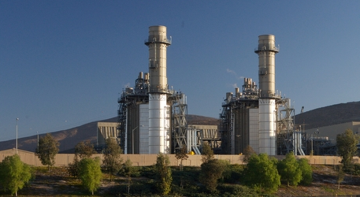
Calpine Overview
Strategically positioned within U.S. power industry value chain
  Fuel Supply
  Retail
  Transportation
  Transmission
  & Distribution
  Power Generation
Created by Investor Relations
Last update: June 2011

Slide 3
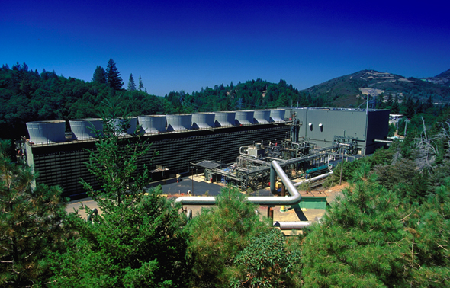
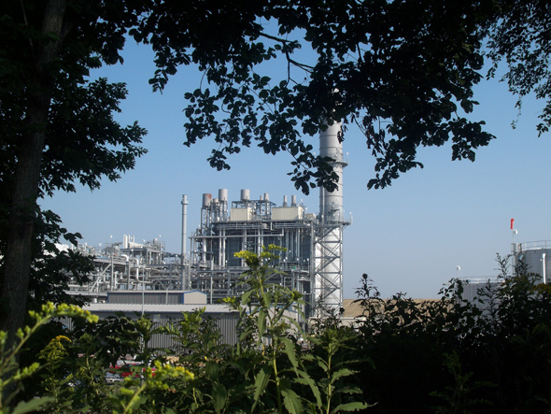
Calpine: Nationally Focused
Largest IPP in US by megawatt hours produced
More than 28,000 MW of capacity from 91 plants in 20 States and Canada
Primarily natural gas-fired
Nation’s largest fleet of highly efficient CHP (cogeneration) plants
Approx. 2,300 Employees
www.calpine.com

Slide 4
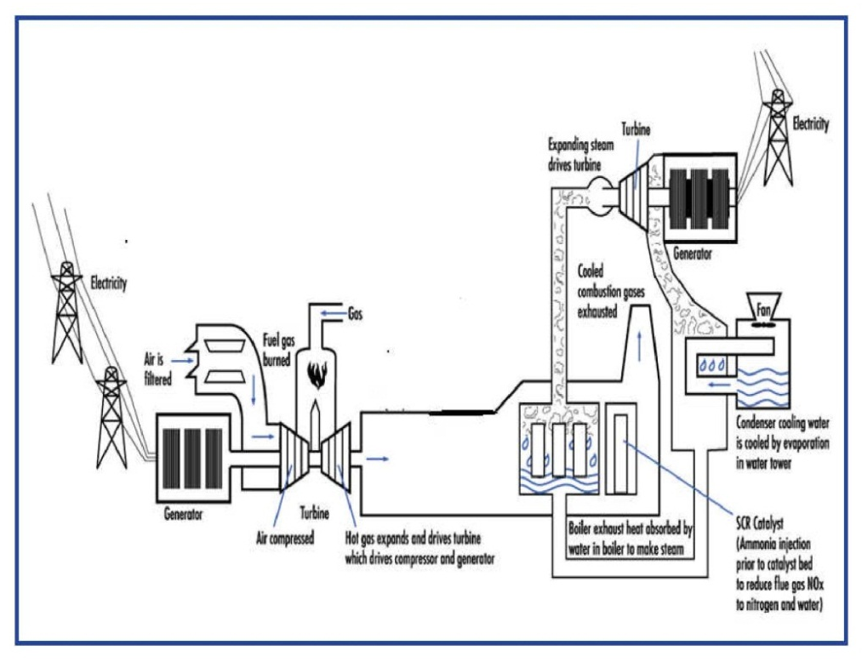
Combined Cycle Power Generation - Overview
Combined Cycle Power Generation each combustion turbine (CT) powers a generator. The high temperature exhaust gas from the CT is used to produce steam in a Heat Recovery Steam Generator. That steam is then used to drive a Steam Turbine generator.
This “Combined Cycle” arrangement ensures the highest efficiency possible from the fuel burned to make electricity.

Slide 5
Introduction to Competitive Procurement
Electricity generation is capital-intensive. A new 1,000 megawatt generating facility requires a capital investment of approximately $1.2 billion;
Consumers and taxpayers are always better off when major spending decisions are subject competitive processes. Competitive bidding ensures that those who are paying the bills are getting the best value for their money;
IPPs – whose core business is power generation – often have significantly more experience in constructing new power plants compared with utilities that have had only infrequent experience is this area.
5

Slide 6
Key Benefits of Competitive Procurement
It’s all about the ratepayer:
Under the traditional cost-of-service utility model, ratepayers are exposed to the financial risks associated with both the construction and operation of new, capital-intensive power plants;
The single most important benefit of relying on competitive procurement is the opportunity to shift the allocation of these significant financial risks away from ratepayers;
  Competitive procurement ensures that resource additions are built and operated at the lowest possible cost.
Utilities have an inherent incentive to maximize ratebase rather than minimize costs;
Power Purchase Agreements with IPPs are binding contracts, subject to state regulatory review and approval;
RFP’s for competitive generating capacity ensure that utility proposals are fairly evaluated against the best alternatives the market has to offer.
6

Slide 7
Key Design Elements for Successful Competitive Procurement “Establishing a Level Playing Field”
According to the National Association of Regulatory Utility Commissioners, In order to ensure fairness, objectivity and a least-cost/best-fit outcome, the competitive procurement process must incorporate the use of standardized criteria:
Involvement of a third-party independent monitor or independent evaluator;
Measures to ensure the transparency of the procurement process to market participants and the public;
Providing potential bidders with detailed information and requirements:
  criteria such as size, new or existing plant, generation type, timing; and any desirable locational, operational, environmental or other non-price characteristics.

Slide 8
Conclusion
The process of Competitive procurement is well suited to getting the least supply solution for the ratepayer with the least amount of risk;
By its very nature competitive procurement shops the market for the best deal.

