Slide 1
Indiana’s Clean Energy Future
Presentation to Regulatory Flexibility Committee
Sept. 18, 2013
Notes:
1
1

Slide 2
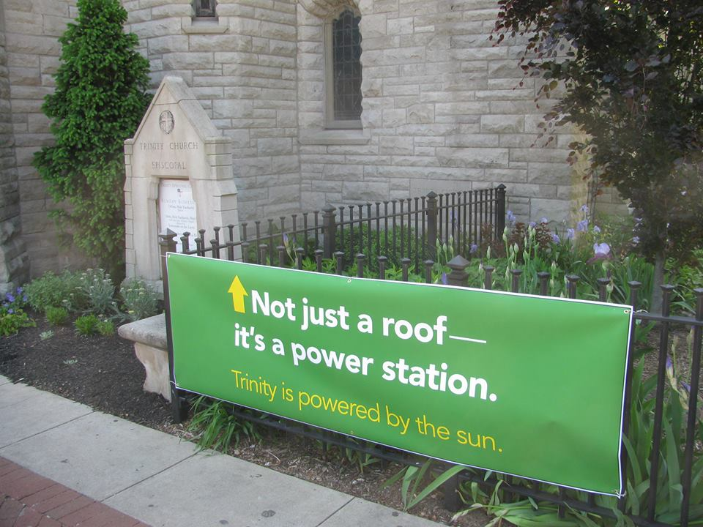
Sustainable Electric Generation Would…
Be affordable (including the ability to decline in cost over time)
Be reliable
Use and consume the least amount of water
Rely on the least polluting resources and methods
Effectively reduce greenhouse gases
Trinity Episcopal Church, Bloomington

Slide 3
Affordability
Certificate of need required by statute in exchange for least-cost service
Utilities must review, but not implement, least-cost options
No agreed-upon formula
Health and environmental costs not taken into account
Automatic rate adjustment mechanisms (trackers), including CWIP, also contribute to rising costs
Ratepayers exposed to volatile fuel prices

Slide 4
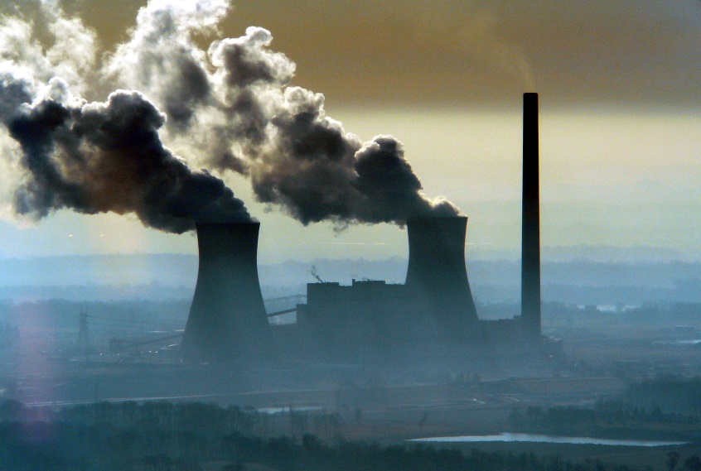
Water Availability/Quantity
No coordinated policy on water availability
65% of Indiana’s total water use is for cooling in coal-fired power plants¹
Coal-related water quality problems and unsafe mercury levels in fish throughout the state²
¹Indiana Water Resources Research Center: http://www.iwrrc.org/
²ISDH: State of the Young Hoosier Child Environmental Health Report

Slide 5
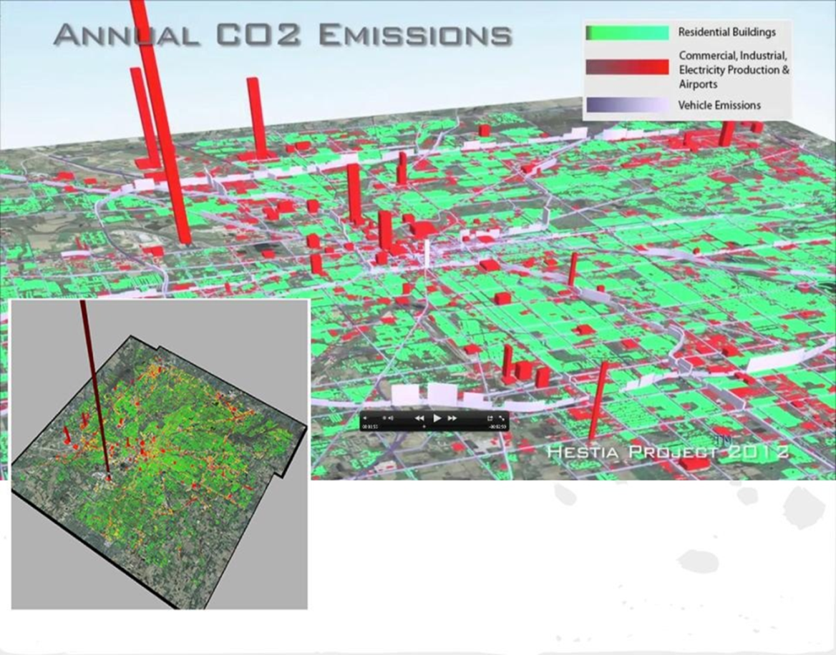
Carbon Pollution
Federal carbon rules coming
No state climate policy or plan
Coal-fired power plants are largest carbon dioxide contributors

Slide 6
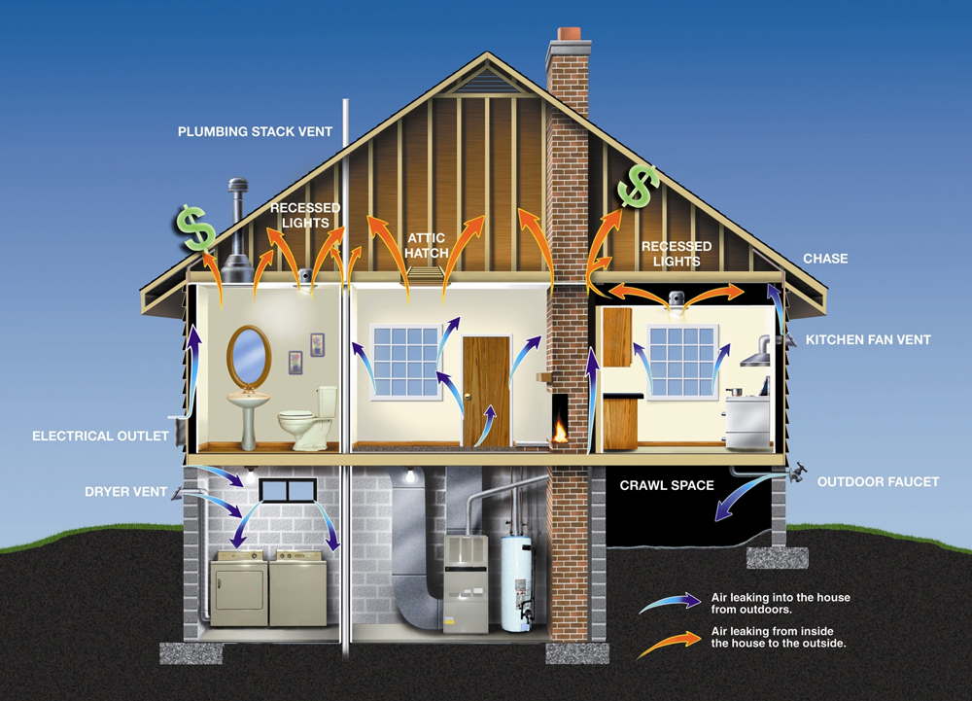
Our Clean Energy Future
Energy efficiency (building efficiency) as the foundation
Distributed power – including wind and rooftop solar, biomass and less polluting resources
Demand-response management
Storage technologies
The least amount of natural gas achievable, with its eventual phase-out

Slide 7
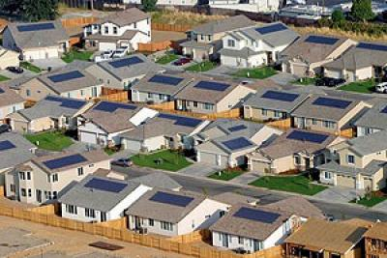
Opportunities and Choice
Distributed renewable generation, storage, end-use energy efficiency and micro-grids
Competitive business opportunities that expand economic opportunity
Greater potential for customer choice, diversity and competition
Can be implemented with protections for ratepayers

Slide 8
Policies that Hold Us Back
Centralized generation of electricity
No mandatory renewable energy standard to encourage gradual shift toward carbon-free energy
Weak standards for protecting consumers in utility rate cases (CPCN, CWIP, trackers)
No competition or least-cost decision-making required in utility capital decisions
Restrictions on distributed generation (who can participate, how it’s financed)

Slide 9
Policies We Support
Protect and improve the Commission-imposed energy efficiency requirements
Improve incentives for renewables and efficiency
Improve net metering and feed-in tariff opportunities for renewable energy
Expand participation
Allow creative financing
Increase energy savings opportunities for schools, local governments, universities, etc.

Slide 10
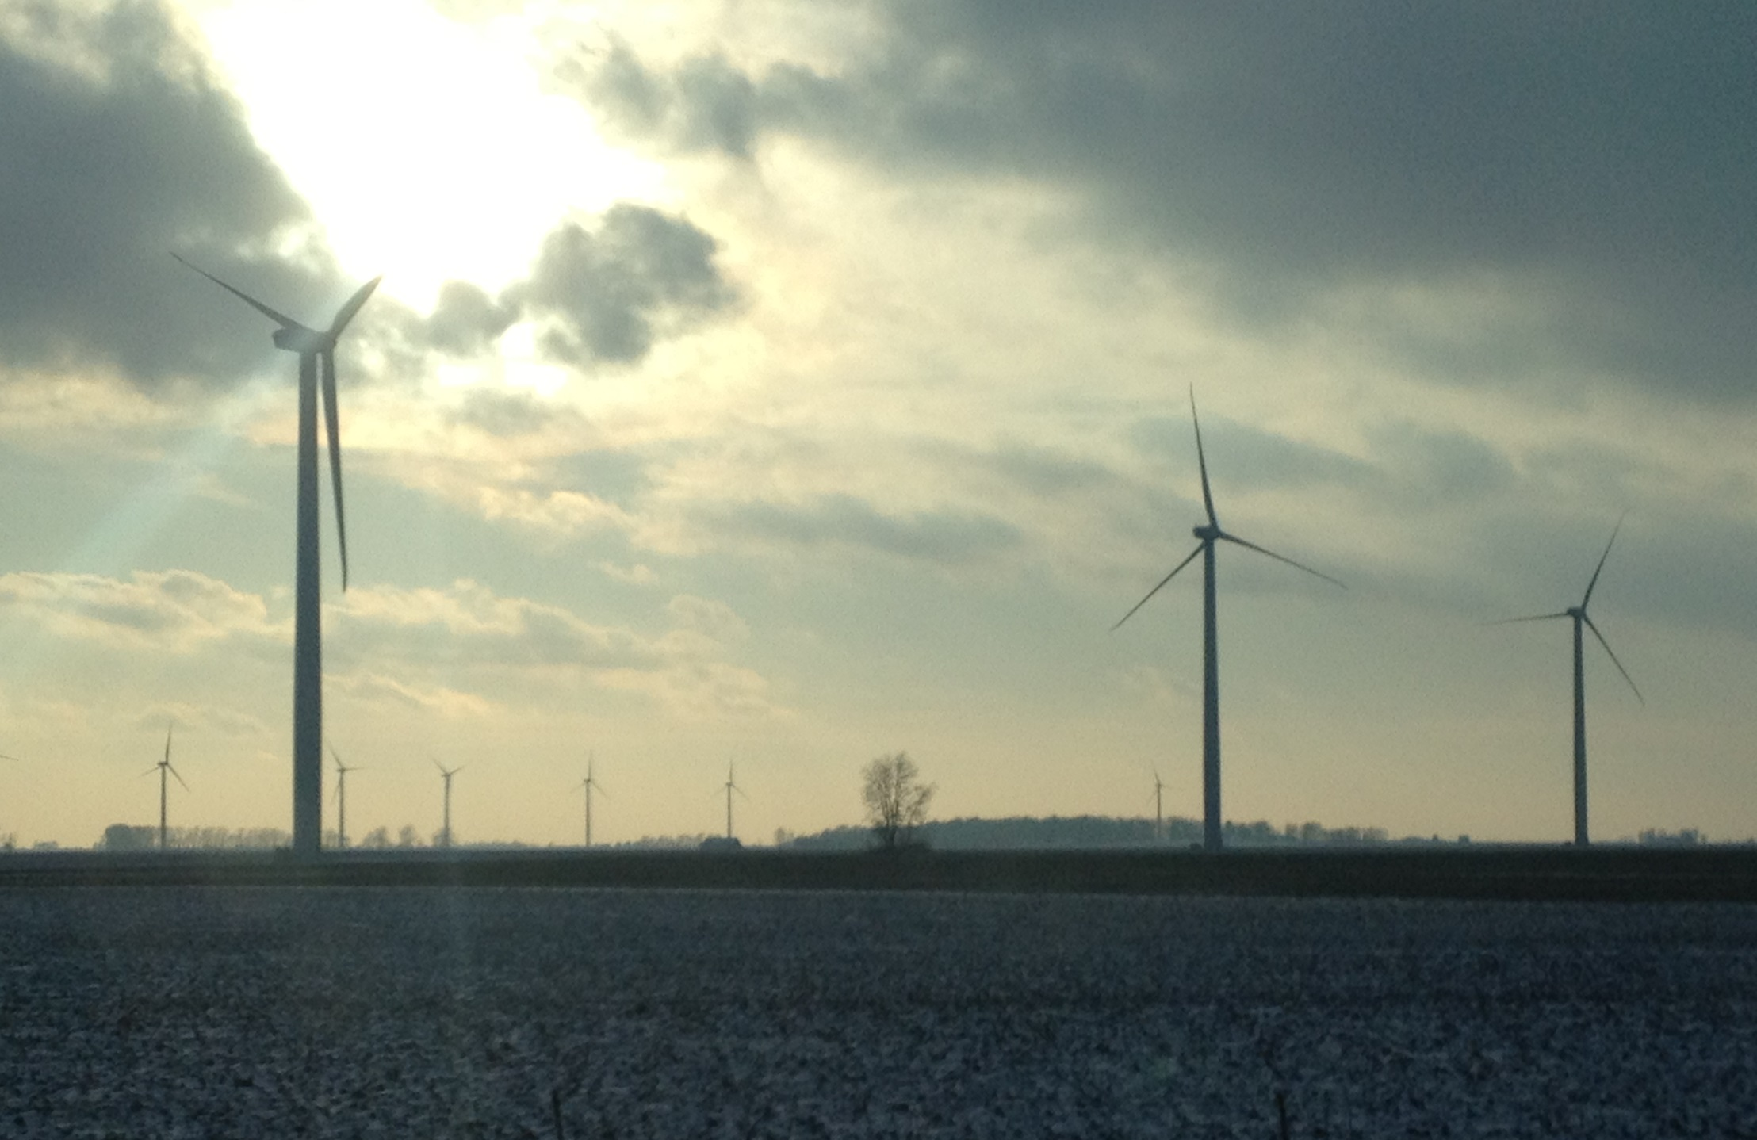
Thank You
Jodi Perras
Indiana Campaign Representative
Sierra Club Beyond Coal
Jodi.perras@sierraclub.org
317-296-8395

