Slide 1
Residential & Low-Income Consumers & Customer Choice
September 18, 2013
Presentation to Regulatory Flexibility Committee

Slide 2
“Basic electric and natural gas service are essential to all residential customers and the affordability of those services for low income customers whose energy burden is high in relationship to their income is crucial. The lack of affordable electricity and natural gas for home heating, refrigeration, and cooling is not the equivalent of the retail market for most other consumer goods and services, for which substitutes exist. The lack of affordable electricity or natural gas for heating and cooling has dire consequences for residential customer health and safety.”
AN ANALYSIS OF RETAIL ELECTRIC AND NATURAL GAS COMPETITION:
RECENT DEVELOPMENTS AND POLICY IMPLICATIONS FOR LOW INCOME CUSTOMERS
June 2013, Barbara Alexander

Slide 3
Indiana’s experience NIPSCO Residential Choice
NIPSCO Commodity Price (per therm): September 2013 (changes monthly) = $0.293
Constellation = $0.539
Just Energy = $0.530 to $0.650
Direct Energy = $0.629
Santanna Energy = $0.539
Spark Energy = $0.525
Xoom Energy = $0.607
http://www.nipsco.com/en/our-services/NIPSCO-Choice/choice-residential-plans.aspx

Slide 4
NIPSCO CHOICE (cont’d) commodity $ + storage/transportation $ per therm
Constellation: 67.2% higher
Just Energy: 62.9% - 94.9% higher
Direct Energy: 86.4% higher
Santanna: 65.1% higher
Spark: 64.3% higher
Xoom: 85.9% higher

Slide 5
Illinois Residential Gas Choice
Consumers Utility Board (CUB) – Gas Market Monitor
Analyzed 6,063 plans since 2003
94% of consumers who chose alternative supplier lost money
$1,190.64 average loss over the life of the plan
http://www.citizensutilityboard.org/GasMarketMonitor.php

Slide 6
New York: Niagara Mohawk (National Grid affiliate)
Evaluated 8,709,449 residential customer gas and electric bills over 24 months.
84% of electric bills and 92% of gas bills of those who switched were higher.
$500 more for electricity and $260 for gas.
This represents approximately $130M more for 24 months than they would have paid.
Low Income – 91.5% of electric and 93.4% of gas bills were higher.

Slide 7
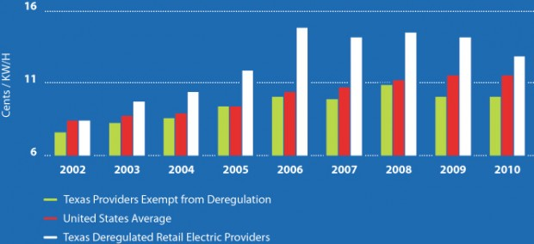
Texas
Customers paid $3,000 in added costs over the last ten years because of deregulation.
This amounted to Texans spending $11 billion more cumulatively.
January 2012, report by Texas Coalition for Affordable Energy
http://historyofderegulation.tcaptx.com/

Slide 8
Other experiences
Pennsylvania – 70% of PPL Electric low income customers paid more than they otherwise would have if they had stayed with default provider.
Ohio - Columbia Gas of Ohio indicates that customers who switched providers have paid over $861 million more for natural gas.
Canada - 2011 Report by the Office of the Auditor General of Ontario showed a customer using 1K kWh/year would pay about $2,000 more for electricity over a 5 year period.

Slide 9
Risks to Residential Customers*
Higher prices for essential service;
Predatory, deceptive market practices;
Volatile and unaffordable bill impacts;
Poor customer service from suppliers;
Hidden fees, additional costs;
Higher prices for distribution services due to costs associated with the transition to a restructured market
Comments by AARP, AZ Corporation Commission
Generic Docket No. E-00000W-13-0135, July 15, 2013

Slide 10
Thank You!
Citizens Action Coalition
603 E. Washington St, Suite 502
Indianapolis, IN 46204
(317) 205-3535
kolson@citact.org

Slide 11
Additional sources
New York: Direct Testimony of William D. Yates, C.P.A., on behalf of the Public Utility Law Project of New York, Inc., before the NY PSC, Proceeding for Niagara Mohawk Power Co. for Natural Gas and Electric Rates, Case No. 12-G-0202 and Case No. 12-E-0201 (August 31, 2012)
Pennsylvania: Direct Testimony of Stephen Krone, on behalf of Coalition for Affordable Utility Services and Energy Efficiency in Pennsylvania, before the PA PUC, Petition of PPL Electric Utilities Corporation for Approval of a Default Service Program and Procurement Plan, Docket No. P-2012-2302074 (July 20, 2012).
Canada: This Report is available from the Auditor General at http://www.auditor.on.ca/en/reports_en/en11/302en11.pdf

