Slide 1




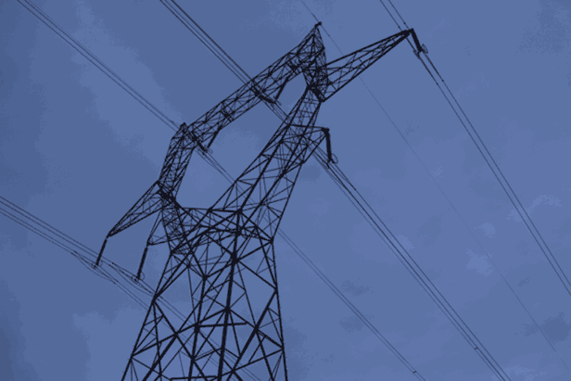

Indiana Office of
Utility Consumer Counselor
A. David Stippler, Indiana Utility Consumer Counselor
Remarks to the Regulatory Flexibility Committee
September 18, 2013

Slide 2

Overview
OUCC’s Mission Effectiveness
  Dedicated Advocacy
  Creative Problem Solving
  Consumer Education
SB 560
  OUCC Activities to Date
  Associated Costs

Slide 3
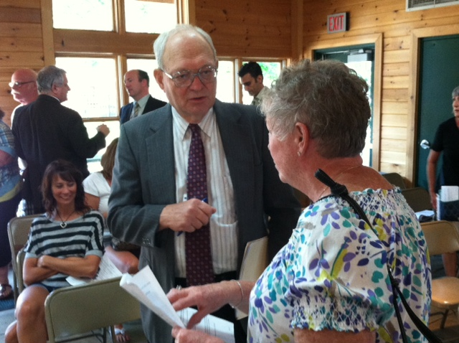
OUCC Mission
“To represent all Indiana Consumers to ensure quality, reliable utility services at the most reasonable prices possible through:
  dedicated advocacy,
  consumer education, and
  creative problem solving.”
Demonstrating value for all Indiana ratepayers: Over $1B in savings in FY’13.

Slide 4
Number of Cases With OUCC Activity During FY 2011, 2012 and 2013

Slide 5

Dedicated Advocacy
Duke Energy (IGCC Edwardsport)
(Cause No. 43114 IGCC4 S1)
  Over $900M in ratepayer savings from settlement agreement
  Capped cost savings of over $2B over
  next 30 years

Slide 6
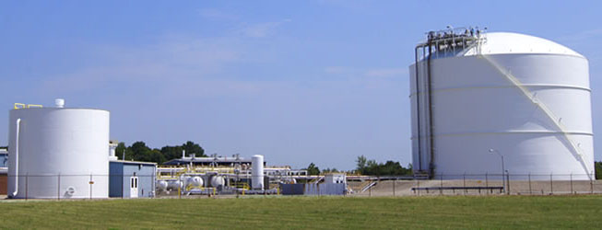
Creative Problem Solving
Citizens Gas / LNG Indy, Inc.
  (Cause No. 44277)
  Approval of Liquefied Natural Gas Settlement Agreement
  Sale of natural gas as a transportation fuel; economic and environmental benefits

Slide 7
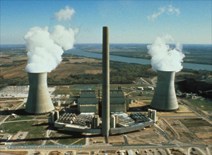
Creative Problem Solving
Indiana Michigan Power Company (I&M)
(Cause No. 44331)
  Settlement Agreement to
  cost-effectively meet federal consent decree requirements for the Rockport generating station

Slide 8
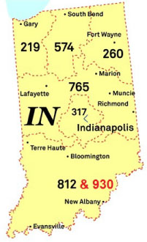
Consumer Education
812 Telephone Area Code Relief
  (Cause No. 44233)
  Educating consumers on:
    Options available for adding a new area code
    Upcoming transition
    www.in.gov/oucc/2718.htm
IURC’s adoption of the “930”
Area Code Overlay (7/31/2013)

Slide 9
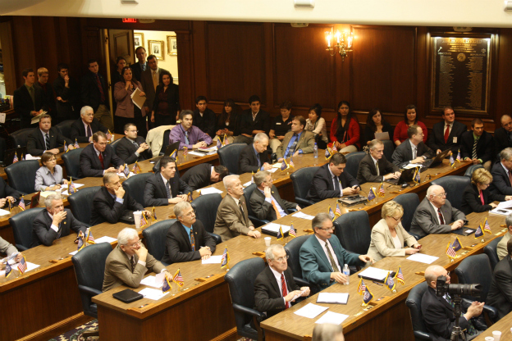
SB 560
IC 8-1-1.1-6.1(h)
“(h) The consumer counselor may submit to the budget agency a request for funds sufficient to carry out any new duties or responsibilities created under IC 8-1-39-12(b).The consumer counselor shall include in its annual report to the regulatory flexibility committee:
(1) a description of its activities under
IC 8-1-39-12(b)
(2) a summary of the costs associated with those activities.”

Slide 10
TDSIC Filings
NIPSCO: First utility filing for TDSIC relief
(July 19, 2013)
NIPSCO’s “Electric Infrastructure Modernization Plan”
  7-year plan, 210-day IURC proceeding (Cause No. 44370)
NIPSCO concurrently filed a 90-day “shell” petition without specific proposed rate schedules (Cause No. 44371)
NIPSCO has waived its right to receive an IURC Order in 90 days, asking for schedule to run concurrently with 210-day proceeding

Slide 11
TDSIC Filings
NIPSCO’s approach recognizes this is its initial filing under the new law
It further recognizes that the IURC must determine the appropriate cost allocation methodology before approving rate schedules
NIPSCO’s 7-year Plan projects the expenditures of about $1B over the term

Slide 12

TDSIC Filings
OUCC activities to date
  Formulation of initial case team
  Review and analysis of NIPSCO filings underway
  OUCC’s testimony due on Oct. 11, 2013
  Keeping track of costs related to activities
  Ongoing assessment of new law’s impact on OUCC resources

Slide 13
Contact Information
David Stippler
Utility Consumer Counselor
www.in.gov/oucc
Phone: 317.232.2494
Direct: 317.233.3232
Toll Free: 1.888.441.2494

