Slide 1
Discussion of
Feed-in Tariff Pilot Programs
September 18, 2013
Presentation to the Regulatory Flexibility Committee of the Indiana General Assembly

Slide 2
Outline of Discussion
Purpose & Variables of a Feed-in Tariff
  Purpose and Design of Feed-in Tariffs (FIT)
  Comparison of Pilot Programs
  Pricing Considerations
  National Policy Discussion
Observations of the Programs
  IPL & NIPSCO
  General Observations
  Renewable Energy Certificates (RECs)
IND Solar Farm (Indianapolis Airport) Update

Slide 3
Purpose & variables of a fit

Slide 4
Design of a Feed-in Tariff (FIT)
Purpose of the Pilot FIT Programs:
  Determine the types of technologies that work within the framework
  Determine customer interest in FIT, and provide a defined program for FIT customers
  Identify contract issues that arise
  Identify other market drivers
  Determine how these projects interact within our distribution systems
Program design considerations:
  Contain rate impacts on all other customers
  Differing unit output and capital costs
  Significant tax subsidies
  Renewable generation costs more than conventional resources
  Utility-specific reasons to explore biomass

Slide 5
Differences between Feed-in Tariffs and Net Metering
 | NIPSCO FIT | IPL FIT | Net Metering
Summary | Each program provides: opportunity for customers to participate in renewable generation, above-market incentive / subsidy to support development of such facilities and defined terms and conditions for participation
Payment | Payment check sent to customer for production | Payment check sent to customer for production | No exchange of money; simply a billing credit mechanism
Program Cap | 30 MW with small facility carve-outs | Approx. 1% of sales = Approx. 100 MW | 1% of System peak load
Contract | 15 years, monthly payments, fixed prices | 15 years, monthly payments, fixed prices | Indefinite term, Excess kWh credited to next month’s bill
Project Size | 5 kW - 5 MW | 20 kW - 10 MW | Up to 1 MW
Technologies | Wind, Solar PV, Biomass, New Hydro | Wind, Solar PV, Biomass | Wind, Solar PV, New Hydro
Purchase Rate | Varies by Technology: $0.10 - $0.30/kWh | Varies by Technology: $0.075 - $0.24/kWh | Bill credit at full retail rate
Environmental Attributes | Included in purchase price, retained by utility | Included in purchase price, retained by utility | Retained by Customer

Slide 6
Feed-in Tariff Pricing Variables
Estimated energy outputs for representative project(s) for each technology
Contract term
Capital cost of installation
Operations and maintenance costs
Discount rate for purposes of financing
Federal investment tax credit
Tax effect of accelerated depreciation
Inflation

Slide 7
Relative Power Prices

Slide 8
National Policy Discussion
Debate Continues
  Typically renewable energy can be acquired by the utility from producers at lower costs than through net metering and feed in tariffs
  Balance between support of renewable energy growth and cost-shifting to non-participating customers
  Protections for other customers such as program caps / fixed charges
Fitch Bond Rating Agency (July 2013)
  “Integrating renewable and energy efficiency policies into an equitable customer rate design remains among the largest challenges facing the U.S. utility industry.”

Slide 9
National Policy Discussion (cont.)
Federal Energy Regulatory Commission
  Chairman Jon Wellinghoff (July 23, 2013)
    He recently said that solar generation should not continue to receive subsidies after the initial set of incentives and should instead compete on a market basis with other technologies.
    Yes, it's good to jump-start these technologies initially with some types of subsidies…[b]ut I personally believe that subsidies should be reduced and then eventually eliminated so that we can all compete on a market basis and so consumers can see prices in those markets and then respond to those prices and make decisions based upon that.

Slide 10
Observations of the programs

Slide 11
Incentives and Subsidies
Federal government offers incentives such as you might find in European FITs, but these are not national mandates
Tax incentives and subsidy are drivers to any renewable development
Large developers dominate the marketplace due to tax incentives

Slide 12
Observations - IPL
Customers are not interested in large projects except as a host
Some customers are interested in owning small scale projects

Slide 13
Observations – NIPSCO in-Service (as of September 3, 2013)

Slide 14
Customer Impacts - NIPSCO
Developers’ use of the Queue
Developers cooperate with customers
  Use of the assignment clause in contracts
16 large projects connected in the FIT
  15 have completed or have a pending assignment
Waivers of 12 month requirement

Slide 15
General Observations
Development of larger projects may be better suited in the context of Integrated Resource Planning (IRP)
  Integrated planning for the entire system
  Compliance with mandates
  Optimal siting
  Project quality, control of operations
  Assurance projects will be completed
Technology costs and tax incentives change quickly
Jurisdictional factors
Safety and power quality

Slide 16
Renewable Energy Credits (RECs)
1 MWH = 1 REC
Tradable commodity
  Regulated by the Federal Trade Commission
Oversight
  Utilities, producers and owners must be careful how they characterize the projects
  Taking credit for the renewable energy attributes can void the RECs
RECs can be sold by IPL and NIPSCO

Slide 17
Ind solar farm

Slide 18

IND Solar Farm Update - Characteristics
Over 41,000 PV panels
Annual generation = 18,300,000 kWh
Covers 60 Acres
Phase I Cost = Approx. $30 million
Owned by ET Energy Solutions
Phase I = 9.8 MW

Slide 19
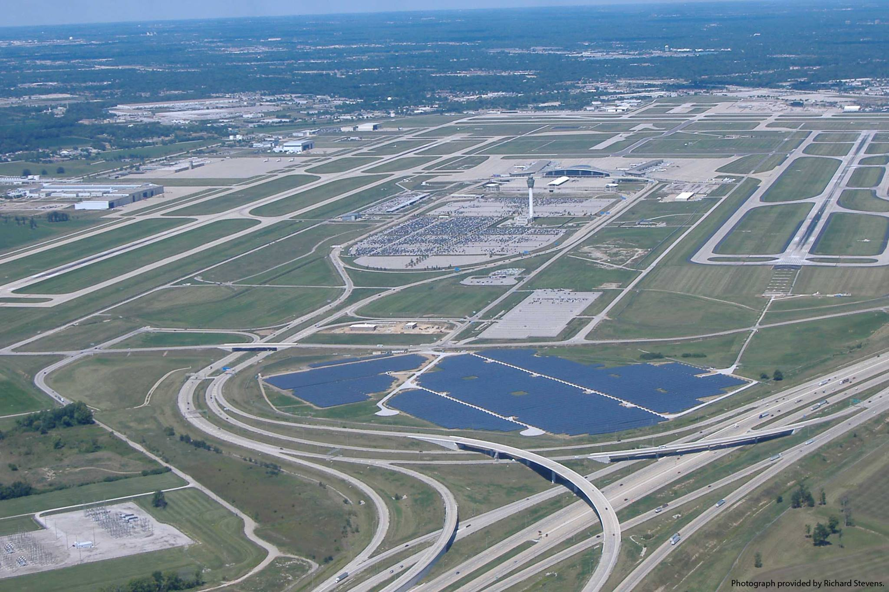
IND Solar Farm Update – 9.8 MW

Slide 20
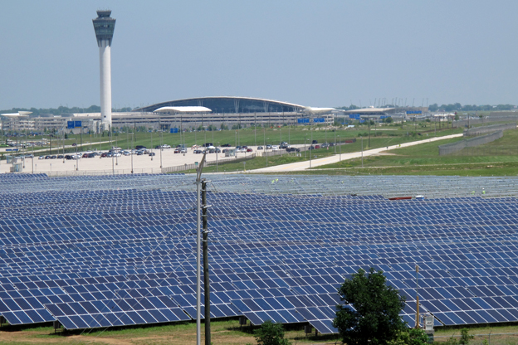
IND Solar Farm Update

Slide 21
QUESTIONS?

