Slide 1
INDIANA SHOULD STUDY ELECTRICITY CUSTOMER CHOICE & INDUSTRY RESTRUCTURING
Regulatory Flexibility Committee
Indiana General Assembly
Philip R. O’Connor, Ph.D.
PROactive Strategies, Inc.
September 18, 2013

Slide 2
THREE REASONS WHY A STUDY OF ELECTRICITY CHOICE IS TIMELY
Indiana is losing its traditional electricity price advantage and the economic benefits. Indiana’s continuing price trend is disadvantageous.
Market conditions and federal regulatory policies warrant a re-evaluation of traditional regulation’s allocation of risk to customers.
A study would be based on the actual experience of more than a dozen states with broad-based operating customer choice programs. It would not be speculative.

Slide 3
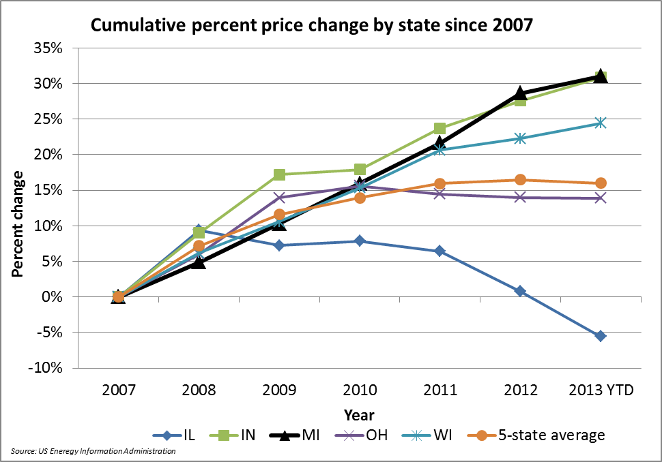
INDIANA & MICHIGAN RATES RISING FASTEST IN UPPER MIDWEST

Slide 4
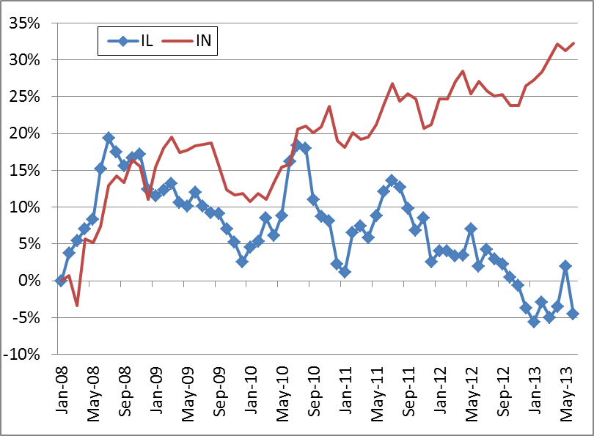
INDIANA v ILLINOIS ALL SECTORS
% PRICE CHANGE JAN2008-JUN2013

Slide 5
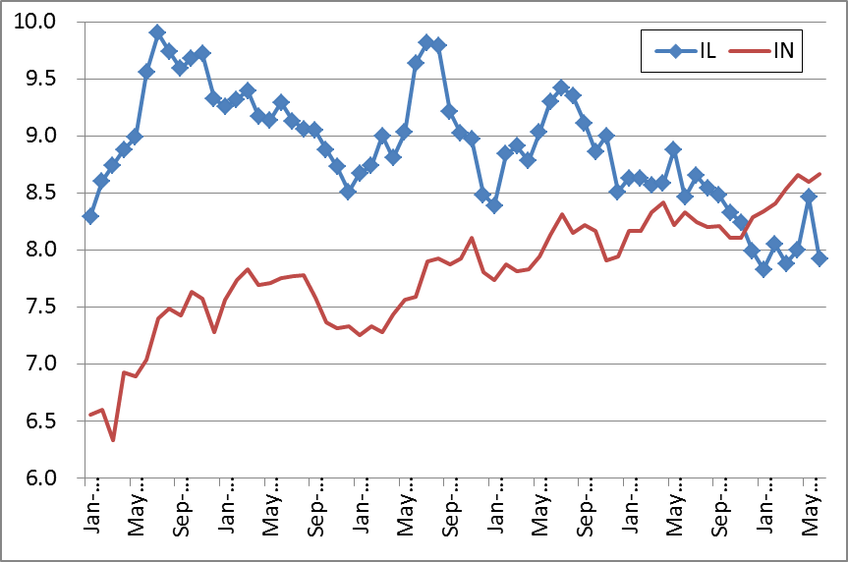
INDIANA v ILLINOIS ALL SECTORS
¢/kWh PRICES JAN2008-JUN2013

Slide 6
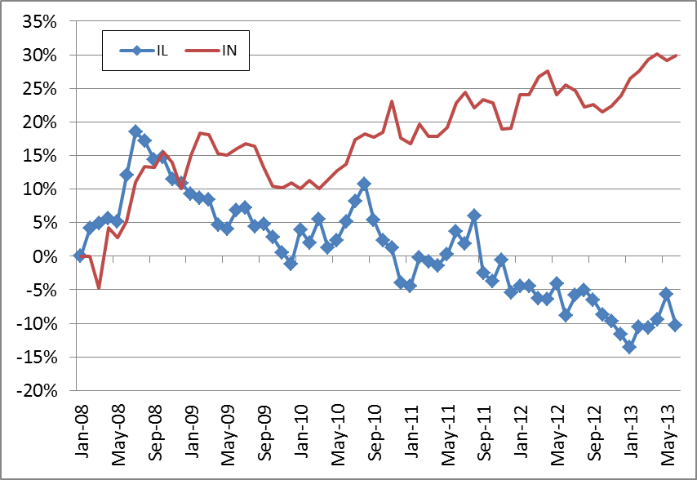
INDIANA v. ILLINOIS C&I PRICES
% CHANGE JAN2008–JUN2013

Slide 7
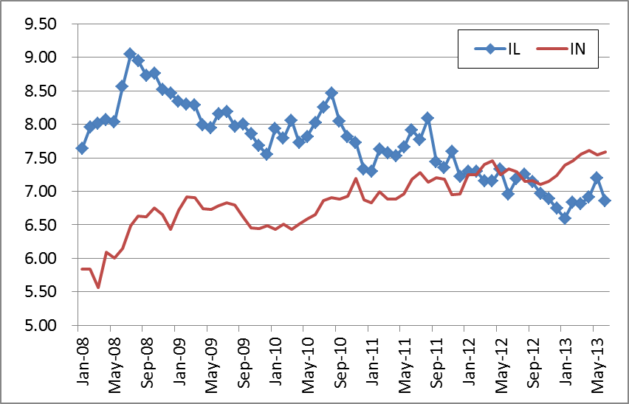
INDIANA v ILLINOIS C&I PRICES
¢/kWh JAN2008–JUN2013

Slide 8
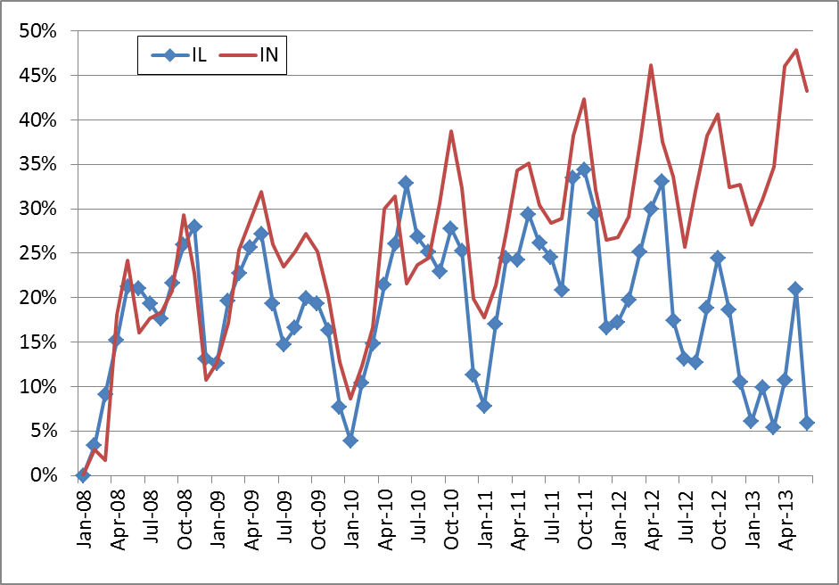
INDIANA v ILLINOIS RESIDENTIAL
% PRICE CHANGE JAN2008-JUN2013

Slide 9
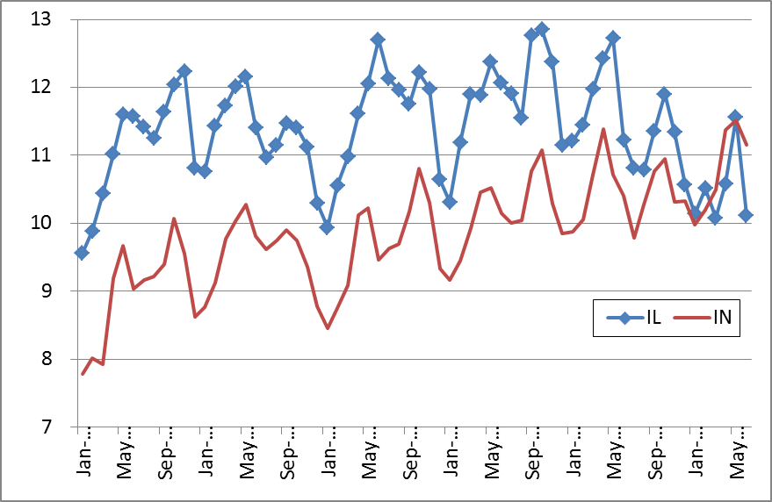
INDIANA v ILLINOIS RESIDENTIAL ¢/kWh JAN2008-JUN2013

Slide 10
RISK ALLOCATION: WHO PAYS FOR UNECONOMIC INVESTMENTS?
Traditional utility regulation, devised in the late-1800s & early-1900s, fit well with the technology & economy that prevailed for a century.
Since 1980s new technologies and fuel markets upheavals have made the generation business intrinsically competitive – not a monopoly.
The traditional regulatory standard of utility “prudence” places the burden of business and investment risk on customers rather than on investors and generation plant management.

Slide 11
RESTRUCTURING & CUSTOMER CHOICE:
RISK IS ALLOCATED IN THE MARKET
States that have restructured the industry & given customers choice have compensated utilities for above-market investments – “stranded costs.”
With a clean start, future investments are made by investors on the basis of the ability to compete with others to control costs & attract customers .
In Indiana, where should the business risk lie for billions of dollars in power plant investment to replace older plants and to comply with federal environmental rules?

Slide 12
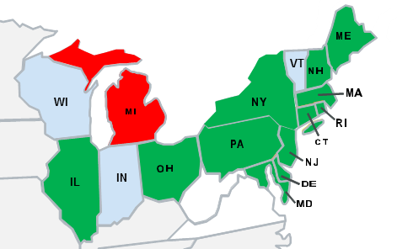
CHOICE IS THE NORM IN THE NORTHEAST QUADRANT OF THE U.S.
DC
Substantial Choice (2012 population of 87 million)
10% Choice Limit (2012 population of 10 million)
No Choice (2012 population of 13 million)

Slide 13
RELIABILITY IS AS GOOD WITH CUSTOMER CHOICE AS UNDER MONOPOLY
States with customer choice have attracted billions of dollars in generation investment.
Competitive & monopoly states both belong to the same regional transmission organizations.
Power industry organizations, federal and state regulators maintain reliability standards.
Independent experts & bodies have not found customer choice to be a factor in outages or other power disruptions.

Slide 14
ALL RESTRUCTURED STATES HAVE ADDRESSED THE BIG ISSUES
Stranded cost compensation for utilities
Devolution of generating plants to market
Setting cost-based, open access delivery rates
Financial integrity of regulated wires utilities
Provider of last resort for small customers
Attracting investment in generating capacity
Customer protection rules & supplier licensing
Mechanisms for facilitating residential choice.
Inclusion of renewable resources in supply.

Slide 15
Philip R. O’Connor, Ph.D.
PROactive-Strategies, Inc. -- Chicago, Illinois
Dr. Phil O’Connor is President of PROactive Strategies, a Chicago consulting firm providing advice in the energy and insurance industries. For over three decades Phil has been recognized as a leading authority on competitive market solutions for regulated businesses.
Phil is the author of Customer Choice in Electricity Markets: From Novel to Normal, published by COMPETE Coalition in November 2010 and co-author with Terrence L. Barnich of “The Grand Experiment: Has Restructuring Succeeded on Either Continent?”, published in Public Utilities Fortnightly, February 2007. He co-authored with John L. Domagalski “Regulation and Relevancy: Assessing the Impact of Electricity Customer Choice,” published in Electricity Policy, June 2012.
In addition to a lengthy career in the private sector, Phil has had extensive government and political experience, serving as Illinois’ chief utility regulator having chaired the Illinois Commerce Commission serving as Director of the Illinois Department of Insurance and as a member of the Illinois State Board of Elections. Five consecutive Illinois Governors have appointed him to various boards and commissions.
From March 2007 to March 2008, Phil served in the U.S. Embassy in Baghdad, Iraq with the US Army Corps of Engineers and the US State Department as an advisor to the Iraqi Ministry of Electricity. A magna cum laude graduate of Loyola University of Chicago, Phil received his Masters and Doctorate in Political Science from Northwestern University.
Phil.OConnor@PROactive-Strategies.net 312-446-3536 312-9804860

