Slide 1
Regulatory Flexibility Committee
September 18, 2013
Direct Energy
Joe Clark
Manager, Government & Regulatory Affairs

Slide 2
Voice of the Customer
A Dog’s Life http://www.youtube.com/user/TheDirectEnergy

Slide 3




Direct Energy’s role within Centrica
Centrica PLC
UK Upstream
UK Downstream
Natural Gas Storage
North America
Direct Energy is a core part of Centrica plc (LSE:CNA)
Centrica is one of the world's leading integrated energy companies with a market cap. of approx. US$28 billion and a credit rating of A3 (Moodys) and A- (Standard & Poors)
Over 30 million customers and +39,000 employees worldwide
A top 30 FTSE100 company, a long-standing member of the Global 500
Operations in the UK, Canada, USA, Norway, Netherlands, Germany, Egypt & Trinidad

Slide 4
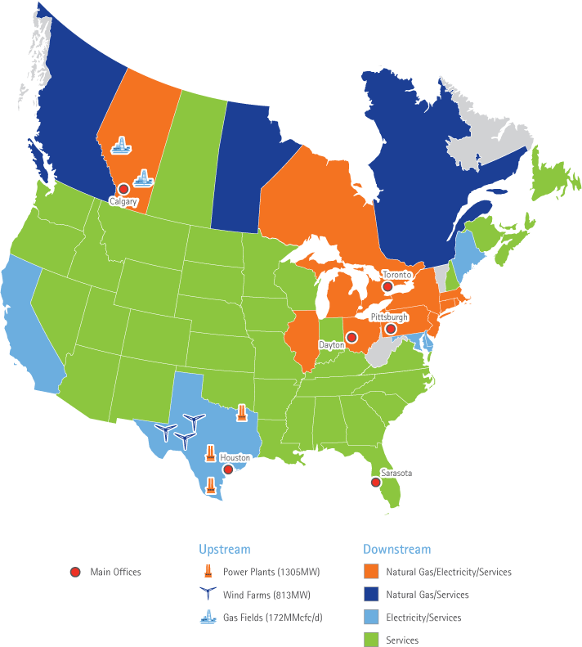
Direct Energy
North American footprint
46 states plus DC and 10 provinces
Supply and Trading
Downstream
DE Business
Providing gas and electricity to C&I customers in Canada, Texas, and U.S. North
Renewable Energy
Nearly 600 MW of Texas wind power contracts
Power
Three gas-fired power stations 1305 MW in Texas
DE Residential
Serving gas and electricity customers in core markets in Canada, Texas, and U.S. North
DE Services
Serving residential and business services customers across North America

Slide 5
What does electric choice look like for customers?
If our customers are not satisfied, we do not exist
Products and services are available to every type of energy customer
Permits customers to take control of their energy budget. Types of products include:
  Fixed rate – budget certainty; remove supply rate fluctuations
  Variable rate products to match how a person or business uses electricity
  Pre-paid product for fixed income families and individuals
  Low-income products/services to assist people with using energy differently to reduce costs
  Renewable energy products and services
  Time of use rates
  Fully integrated energy management service and tools to assist with overall energy strategies incorporating

Slide 6
APPENDIX

Slide 7

Why should Indiana consider restructuring its electric market?
*17 states and D.C. have adopted electric choice
* Competition should displace regulation when functioning marketplace exists – pillar of a capitalistic economy and society
* Other industries (airlines, telephone, cable) restructured
* Indiana law already recognizes competition is “increasing in provision of energy services in Indiana and the US” and that traditional regulation is not adequately designed to deal with increasing competitiveness (IC 8-1-2.5-1)
* Customer choices = customer engagement + innovative products
* Customers more satisfied with suppliers than local utility
* Not “deregulation” – restructured environment where IURC licenses suppliers and maintains jurisdiction over marketing practices and other aspects of customer interactions

Slide 8
REP Customer Satisfaction Scores Higher Than Texas Regulated Electric Utilities
+114

Slide 9
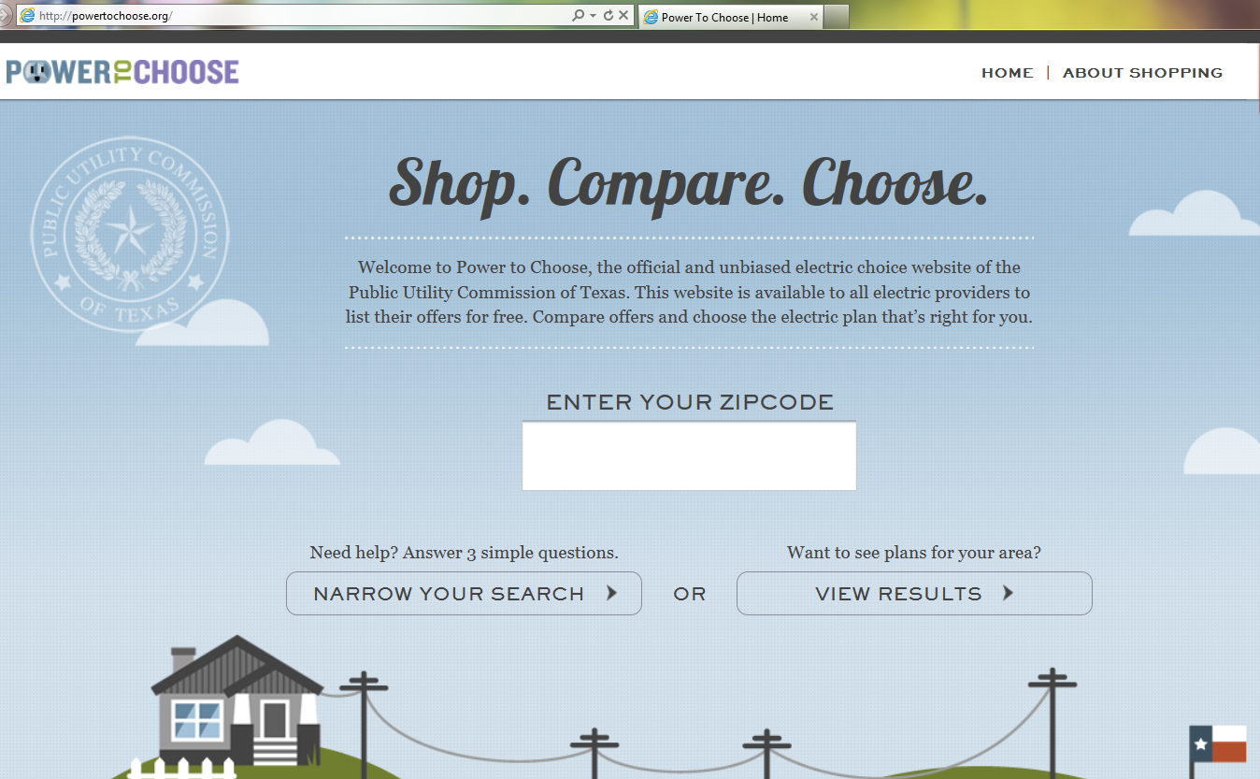

Slide 10
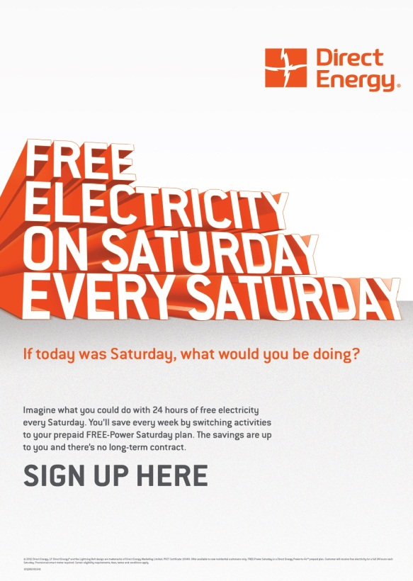
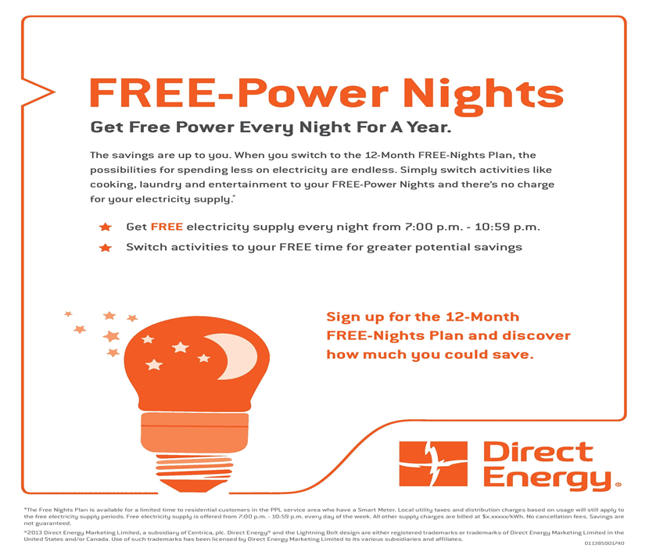
Innovative Products for Customers

Slide 11

















Downstream
Our retail brands across North America
Energy
Services
Note: Brands indicated are either registered trademarks, trademarks and/or trade names used by or under license from Centrica plc and/or its various subsidiaries and affiliated entities.

