Slide 1


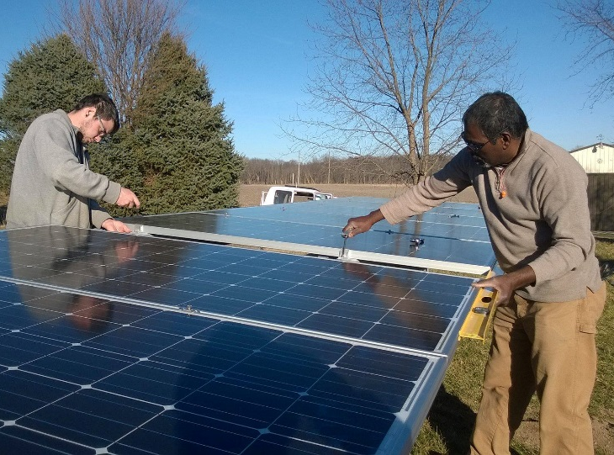
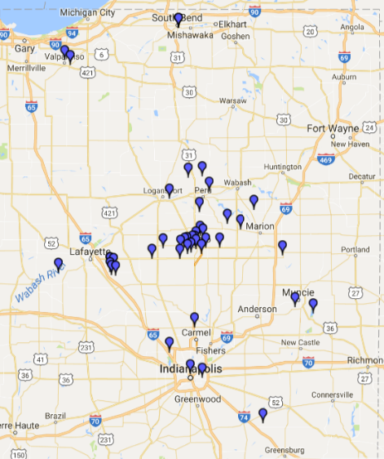
GAI History
Based in Kokomo, IN since 2009
4 Full-time employees
Seasonal Staff
~ 65 Systems, 0.53 Megawatts
Historical CAGR: 30-50% annual
Debt-free
2017 EDGE Award Winners!
GAI President Chris Rohaly
- BSEE from Valparaiso University
- 30+ years design experience
- On the advisory board at Ivy Tech Lafayette Energy Program *
Co-Founder Neal Rhodes
- Kokomo Native
- NABCEP certified
- 30+ years Electrical Technician
GAI serves most of northern IN.
- Our employees are products of Hoosier schools & communities
* Including Ivy Tech Energy program
- Over half our customers are 50+, preparing for low-cost retirements
For more information, contact
Chris Rohaly 765-480-4138
chris @ solarGAI.com

Slide 2


Why we oppose SB309
• SB309 will limit policy mechanisms commonly used to promote solar, such
as power purchase agreements and virtual net metering. In other states, these
are used to expand solar access multiple customer classes. [Chapter 40,
Section 3]
• SB309 puts a kill date on net metering of July 1, 2022. We have set the goal
of 1.5% of peak summer load. Let's allow Indiana's solar industry to get there.
[Chapter 40, Section 10 - (2)]
• SB309 includes a statutory prohibition of net metering, a simple and fair way
to value excess solar being put onto the grid. Even if utilities want to use net
metering, they cannot if SB309 passes. [Chapter 40, Section 11 – (b)(1)]
• As the bill stands, systems installed after 2017 will only get grandfathering for
half of its usable life (30 years or more). [Chapter 40, Section 13 – (b)(2)]
• The bill includes a provision allowing utilities to increase rates on all
customers and attributes the increase to net metering. This is “double dipping”, & will
affect low and middle income Hoosiers the most. [Chapter 40, Section 15]
• By arbitrarily setting rates for excess solar generation, the bill denies the
benefit and transparency of a study at the Indiana Utility Regulatory
Commission, a prudent next step done in about a dozen other states.
[Chapter 40, Section 17]
• SB309 would allow utilities to increase to monthly service charge for solar
customers to be connected to the grid, changing the rules for a small portion of
their customers. [Chapter 40, Section 19]
• SB309 effectively ends the conversation about net metering and solar in
Indiana. This bill is a job killer, limiting customer choice, and stifling
entrepreneurship in the long term. It is a step backward, not forward, in solar
policy in Indiana.
As a Solar Company in Indiana, GAI urges you to vote NO on SB309.
NO on 3 0 9

