Slide 1

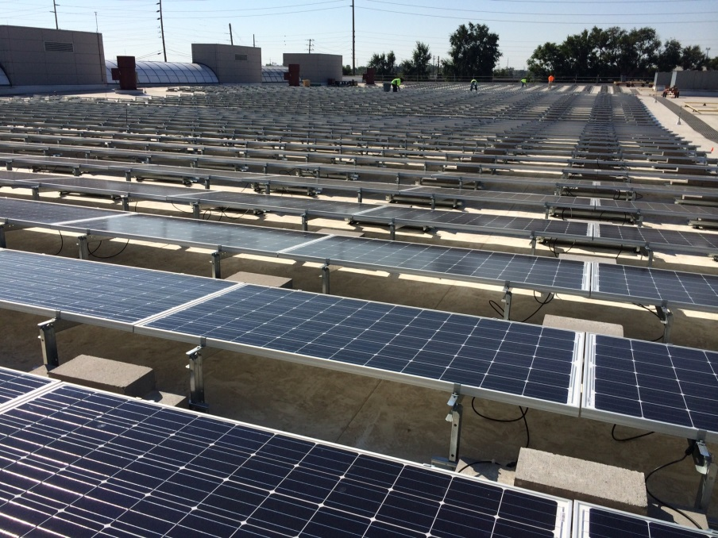
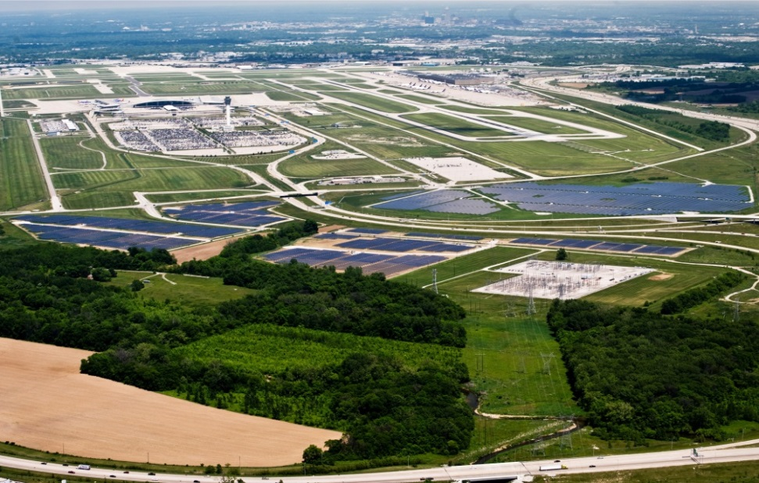
Key Company Statistics
Year Established
2016
Associates
6
Total Megawatts Produced
25
Certified Minority Business Enterprise (MBE)
Who Are We?
Telamon is your Midwestern solar partner with the expertise to design and develop solar arrays in any configuration. Having designed and financed the world’s largest airport-based solar farm at the Indianapolis International Airport and large roof top installations such as the IndyGo Bus Barn, Telamon is a respected leader in solar design, engineering, RFP and construction management. Telamon specializes in mid to large, photovoltaic installations and possesses local understanding, national capabilities and global experience.
What We Do
Financial Feasibility Analysis
Finance options via 3rd Party PPAs
Design and Engineering
RFP Creation and EPC Selection
Construction Project Management
Liaison to Electrical Utility for Connectivity
Project Signoff
Reggie Henderson 317-818-6654
reggie.henderson@telamon.com

