Slide 1

Impact of SEA 309 on customer-owned solar, wind and DG
Presentation for
Governor Eric Holcomb
April 17, 2017
by Indiana Distributed Energy Alliance
(IndianaDG.net)

Slide 2

IndianaDG members ask Gov. Holcomb to veto SEA 309
IndianaDG members ask Gov. Holcomb
  to veto SEA 309; and
  to request the Indiana Utility Regulatory Commission (IURC) to do a study on the costs and benefits of net metering for customer-owned and operated solar, wind and other DG systems.

Slide 3
IndianaDG and its members
IndianaDG has several types of members:
  Solar PV, small wind, biomass & CHP installers (Indiana, Ohio and Kentucky companies);
  Solar PV utility scale developers;
  Solar and wind manufacturers (Fronius and Bergey Wind);
  Non-profit organizations (e.g. Poor Handmaids of Jesus Christ and Notre Dame Energy Center); and
  Individual solar homeowners and homeowners who want and/or support solar.

Slide 4
IndianaDG Business Member
Solar Companies
IndianaDG Member Solar Companies:
  Ag Technologies (Rochester, IN)*
  Alternate Source (Fishers, IN)
  Green Alternatives (Kokomo, IN)*
  ICON Solar (Milford, OH)
  Midwest Wind and Solar (Griffith, IN)*
  Morton Solar (Evansville, IN)
  MPI Solar (Bloomington, IN)*
  360 Sun Solutions (Ft. Wayne, IN)*
  Rectify Solar (Indianapolis, IN)*
  Renewable Energy Systems (RES)-Midwest (Avilla, IN)*
  Solar Energy Solutions (Lexington, KY)
  Solar Energy Systems (Nappanee, IN)
  Solar Systems of Indiana (Bloomington, IN)*
  Solscient Energy (Toledo, OH)
  Solential (Carmel, IN)
  Stumpner Building Services (Bloomington, IN)*
  SunWalk Solar (Ft. Wayne, IN)*
  Whole Sun Designs (Evansville and Bloomington, IN)*
  * denotes company flyer attached

Slide 5
IndianaDG Business Member
Solar Developers
IndianaDG Member Solar Developers (utility scale solar project development):
  Ecos Energy/Allco Renewable Energy (New York, NY)
  Inovateus Solar (South Bend, IN)
  Cypress Creek Renewables (CA)*
  Telamon Energy Solutions (Carmel, IN)*
  * denotes company flyer attached

Slide 6
What’s Encouraging
Distributed Generation?
29 state plus D.C. have RPS programs, 17 with mandates/programs for solar and other DG
Net metering programs – present in 43 states
Feed-In Tariffs – adopted or proposed in a few states
Virtual net metering – present in 14 states
Subsidies, rebates, tax incentives, financing incentives.
Zero net energy goals and targets, microgrids

Slide 7
2015 Indiana General Assembly
HB 1320 introduced by Rep. Eric Koch (R-Bedford), Chairman of House Utilities, Energy and Telecommunications Committee
Hearing held, Received DO PASS
Speaker Bosma did not put on 2nd Reading
Bill died.
No subsequent IURC study or investigation of net metering after HB 1320 died.

Slide 8
What is “buy all, sell all”?
HB 1320 (2015) introduced a new concept to credit customers with roof-top solar and small wind systems.
This is called “buy all, sell all” in which the customer
  Buys all their electricity from the utility;
  Puts all electricity they produce into the grid; and
  Receives credit for electricity produced at the utility’s “avoided cost”.
SEA 309 (2017) as introduced also proposed “buy all, sell all” to replace net metering
Notes:
http://iga.in.gov/information/archives/2015/video/committee_utilities_and_energy_2000/; Select Feb. 18, 2015 to watch committee hearing

Slide 9
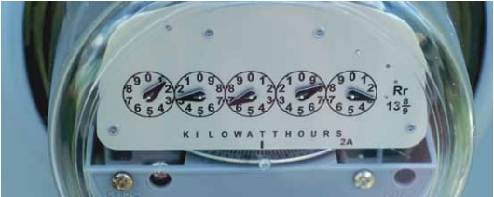
Net Metering
Net metering is a billing arrangement between a customer and their providing electric company.
Net metering applies to a person or group who is generating their own renewable energy on a system that is tied into the electric grid.

Slide 10
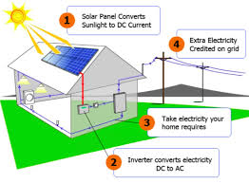
Net Metering Diagram

Slide 11
How Does Net Metering Work?
If an energy customer with a renewable energy system that is tied into the grid doesn’t produce as much as they need, they can still buy the rest of the energy they need as usual.
If a customer produces more energy than they use at any given time, that electricity leaves their system and goes to another location. This excess electricity is metered by the customers electricity provider and they are given credit for each unit of electricity they do not use.

Slide 12
Feed-in tariffs (FITs)
Feed-in tariffs allow for the purchase of all renewable energy generated from an eligible renewable energy facility by the utility.
This is usually for a longer contracted time period and at a designated payment rate.
Both IPL and NIPSCO have offered voluntary feed-in tariffs (VFITs)
  IPL Rate REP
  NIPSCO FIT Phase II just approved

Slide 13
Status of Feed-in tariffs (FITs) vs. Net Metering
There is more than 100 MWs of voluntary FIT contracts with IPL and NIPSCO
  IPL has 97 MWs of solar PV FIT 15 year contracts ranging from $.20 to $.24/kWh
  NIPSCO has 15 MWs of solar PV FIT 15 year contracts from FIT 1.0 ranging from $.26 to $.30/kWh with 2% per year price escalators
As of the end of 2016, there was just under 20 MWs of net metering at retail rates.

Slide 14
IPL Rate REP (Expired FIT)
Technology & size | Energy payment | Capacity payment
Solar: 20-100 kW | $0.24/kWh | Capacity: None
Solar: >100 kW | $0.20/kWh | Capacity: None
Wind: 50-100 kW | $0.14/kWh | Capacity: None
Wind: 100 kW- 1 MW | $0.105/kWh | Capacity: None
Biomass | $0.085/kWh | Capacity: $6.18/kW/mo
Notes:
Cause No. 44018

Slide 15
NIPSCO Feed-in tariff (FIT)
Cause No. 44393 Technology | Phase II MW Available
Micro Solar | 2
Intermediate Solar | 8
Micro Wind | 1
Intermediate Wind | 1
Phase II Biomass | 4
Total | 16

Slide 16
NIPSCO Feed-in tariff (FIT)
Phase I Technology | Phase I Size Limit |  | Phase II Technology | Phase II Size Limit
Wind 1 | ≤ 100 kW |  | Micro Wind | 3 kW and ≤ 10 kW
Wind 2 | > 100 kW and ≤ 2 MW |  | Intermediate Wind | > 10 kW and ≤ 200 kW
Solar 1 | ≤ 10 kW |  | Micro Solar | 5 kW and ≤ 10kW
Solar 2 | > 10 kW and ≤ 2 MW |  | Intermediate Solar | > 10 kW and ≤ 200kW
Biomass | ≤ 5 MW |  | Phase II Biomass | 100 kW and ≤ 1 MW
New Hydro | ≤ 1 MW |  | No longer available

Slide 17
NIPSCO Feed-in tariff (FIT)
Phase I Technology | Phase I Purchase Rate per kWh | Phase II Technology | Purchase Rate per kWh-Years 1 and 2 | Purchase Rate per kWh After Year 2
Wind 1 | $0.1700 | Micro Wind | $0.2500 | $0.2300
Wind 2 | $0.1000 | Intermediate Wind | $0.1500 | $0.1380
Solar 1 | $0.3000 | Micro Solar | $0.1700 | $0.1564
Solar 2 | $0.2600 | Intermediate Solar | $0.1500 | $0.1380
Biomass | $0.1060 | Phase II Biomass | $0.0918 | ≤ $0.0918
New Hydro | $0.1200 | No longer available

Slide 18
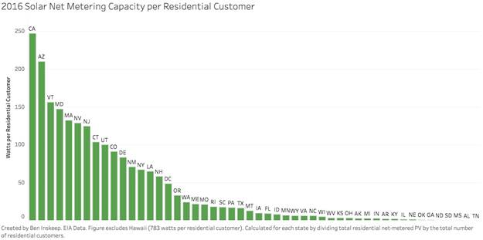
How Indiana net metering compares to other states?

Slide 19
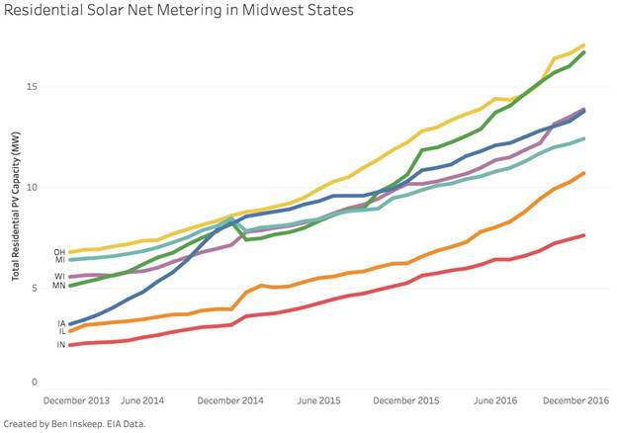
How Indiana net metering vs. other Midwest States

Slide 20
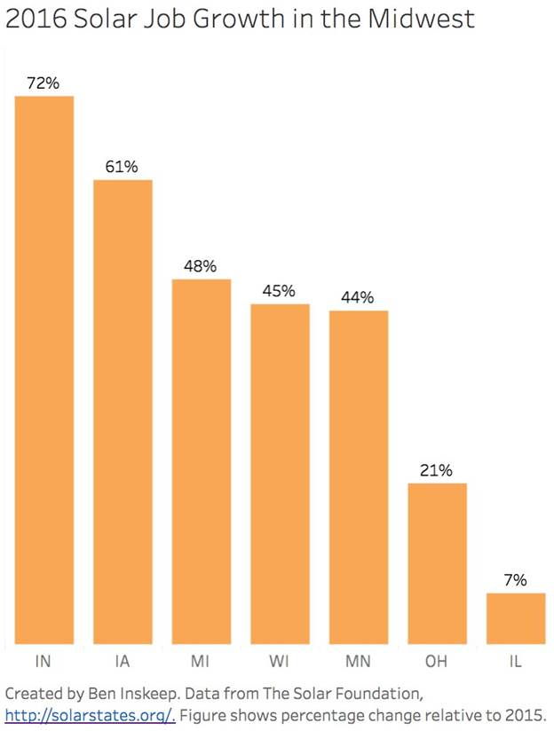
2016 Solar Job Growth in
Midwest States

Slide 21
GTM- SEIA
U.S. Solar Market Insight Q4 2016--State Solar PV Installation Rankings
State | Cumulative | 2015 | Q3 2016 | Midwest Rank
INDIANA | 20 | 23 | 17 | 1
Missouri | 21 | 24 | 24 | 2
Minnesota | 32 | 29 | 26 | 3
Michigan | 35 | 35 | 33 | 4
Illinois | 29 | 30 | 34 | 5
Iowa | 33 | 34 | 35 | 6
Wisconsin | 34 | 36 | 36 | 7
Ohio | 24 | 32 | 37 | 8

Slide 22
History of net metering in Indiana
Before the current net metering rule was adopted by the IURC, Indiana’s net metering received a grade of “F” from Freeing the Grid in 2007, 2008 and 2009.

Slide 23
Net Metering Grades 2007
www.freeingthegrid.org / November 2009
DC: F
Grade = A
Grade = B
Grade = C
Grade = D
Grade = F
No Statewide policy

Slide 24
Net Metering Grades 2008
www.freeingthegrid.org / November 2009
DC: C
Grade = A
Grade = B
Grade = C
Grade = D
Grade = F
No Statewide policy

Slide 25
Net Metering Grades 2009
www.freeingthegrid.org / November 2009
DC: B
Grade = A
Grade = B
Grade = C
Grade = D
Grade = F
No Statewide policy

Slide 26
Indiana IOU 2007 Net Metering Summary
Investor Owned Utility (IOU) | Total Number of Net Metering Customers and Facilities | Number, Size and Type of Net Metering Facilities
Duke Energy Indiana | 30 | 29 – solar ranging from 1.0 to 28.8 kW 1 – 9.0 kW wind
Indiana Michigan Power | 1 | 1 – 1.1 kW solar
IPL | 5 | Total capacity of 6.86 kW solar
NIPSCO | 4 | 1 – 2.5 kW solar 1 – 1.36 kW solar 1 – 640 W solar 1 – 10.0 kW wind
SIGECO/Vectren | 1 | 1 – 5.0 kW solar

Slide 27
Comparison of previous vs. current net metering rules
 | Previous rule | Current rule
Technologies included | Wind, solar, hydro | Expanded list of technologies but not CHP
Customers eligible | Residential & K-12 schools | All customers
Program cap | .1 % summer peak load | 1% summer peak load with 40% reserved for residential customers
Customer capacity | 10 kW | 1 MW (1000 kW)

Slide 28
History of net metering in Indiana
Freeing the grid now ranks Indiana’s net metering rule as a “B”.
Indiana’s current net metering rule is pretty good now

Slide 29
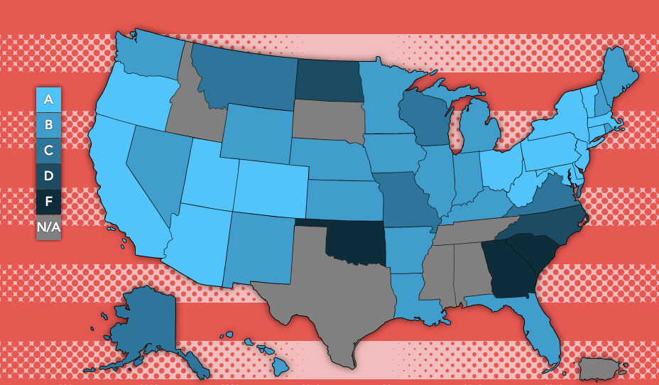
Freeing the Grid:
State Report Card on Net metering

Slide 30
IndianaDG’s suggested changes to Indiana’s net metering policy
Add aggregate net metering
Add community net metering
Add remote or virtual net metering
Add third party leasing net metering (NIPSCO allows now)
Clarify that net metering customers own RECs or SREC’s NOT the utility
Increase max. system size to 5-10 MWs
Increase utility cap from 1% to 2-5% of utility’s summer peak
Add combined heat and power (CHP) or cogeneration to list of eligible net metering technologies.
Create uniform statewide net metering policy by expanding to REMC’s and municipal electric utilities.

Slide 31
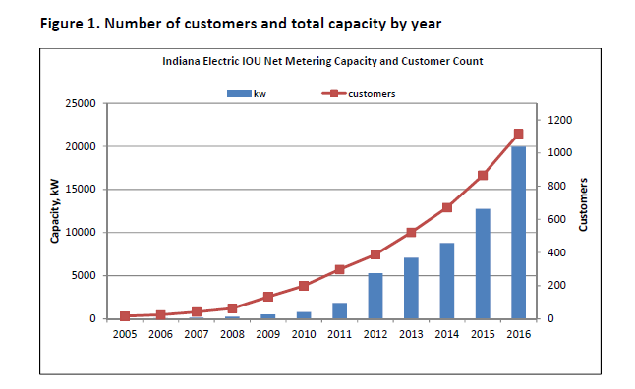
Figure 1. Number of customers and total capacity by year
Notes:
Updated

Slide 32
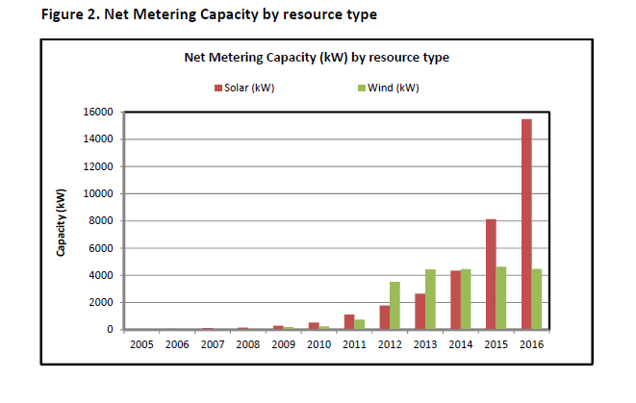
Figure 2. Net Metering capacity by resource type
Notes:
Updated

Slide 33
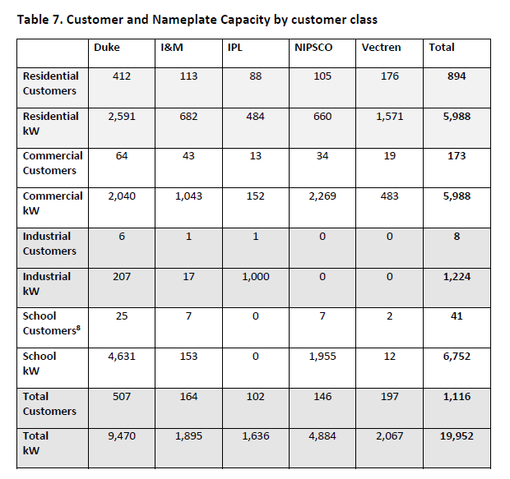
Table 7. Customer & Nameplate
Capacity by customer class-2016
Notes:
Updated

Slide 34
Table 1. Nameplate Capacity by utility & by resource type (2016)
Utility | Total (kW) | Solar (kW) | Wind (kW)
Duke Energy Indiana | 9470 | 7260 | 2209
NIPSCO | 4884 | 2831 | 2053
SIGECO (Vectren) | 2067 | 2051 | 16
I&M | 1895 | 1748 | 147
IPL | 1636 | 1586 | 50
Total 2016 | 19952 | 15476 | 4476
Notes:
Updated

Slide 35
Table 2. Total Nameplate
Capacity growth year over year
Year | Capacity (kW) | % change | Absolute change
2005 | 23
2006 | 66 | 188% | 43
2007 | 140 | 111% | 74
2008 | 233 | 66% | 92
2009 | 504 | 117% | 271
2010 | 783 | 55% | 280
2011 | 1,852 | 136% | 1,068
2012 | 5,297 | 186% | 3,445
2013 | 7,087 | 33.8% | 1,790
2014 | 8,791 | 24% | 1,704
2015 | 12,742 | 45% | 3,951
2016 | 19,952 | 57% | 7,210
Notes:
Now updated

Slide 36
Table 3. Solar Nameplate
Capacity Growth year over year
Year | Capacity (kW) | % change | Absolute change
2005 | 23
2006 | 66 | 188% | 43
2007 | 121 | 83% | 55
2008 | 167 | 38% | 46
2009 | 307 | 84% | 140
2010 | 529 | 72% | 221
2011 | 1119 | 112% | 591
2012 | 1789 | 60% | 670
2013 | 2657.5 | 49% | 868.5
2014 | 4,346 | 64% | 1,689
2015 | 8,123 | 87% | 3,777
2016 | 15,476 | 91% | 7,353
Notes:
Updated now

Slide 37
Table 4. Wind Nameplate
Capacity growth year over year
Year | Capacity (kW) | % Change | Absolute change
2005 | 0
2006 | 0
2007 | 19 |  | 19
2008 | 65 | 243% | 46
2009 | 196 | 202% | 131
2010 | 255 | 30% | 58
2011 | 732 | 187% | 477
2012 | 3509 | 379% | 2777
2013 | 4431 | 26% | 922
2014 | 4446 | 0% | 15
2015 | 4620 | 4% | 174
2016 | 4476 | -3% | -144
Notes:
Updated now

Slide 38
Table 5. Customer participant growth year over year
Year | # Customers | % Change | Absolute Change
2005 | 16
2006 | 24 | 50% | 8
2007 | 41 | 71% | 17
2008 | 63 | 54% | 22
2009 | 133 | 111% | 70
2010 | 199 | 50% | 66
2011 | 298 | 50% | 99
2012 | 388 | 30% | 90
2013 | 523 | 35% | 135
2014 | 671 | 29% | 149
2015 | 866 | 29% | 195
2016 | 1,116 | 29% | 250
Notes:
Updated now

Slide 39
Table 6. Net metering cap as
% of summer peak load 2013
Utility | 2012 Summer Peak Load (MW) | 2013 Net Metering Cap (1% summer peak load) | 2013 Actual net metering (MW) | % of Net Metering Cap
Duke Energy Indiana | 6490 | 64.9 | 3.6678 | 5.65%
NIPSCO | 3026 | 30.26 | 2.3063 | 7.62%
I&M | 4726 | 47.26 | 0.509 | 1.08%
SIGECO | 1158 | 11.58 | 0.4264 | 3.68%
IPL | 2866 | 28.66 | 0.1780 | 0.62%
Total | 18266 | 182.66 | 7.0875 | 3.88%

Slide 40
Table 7. Net metering cap as
% of summer peak load 2014
Utility | 2013 Summer Peak Load (MW) | 2014 Net Metering Cap (1% summer peak load) | 2014 Actual net metering (MW) | % of Net Metering Cap (% of 1% cap)
Duke Energy Indiana | 6,215 | 62.15 | 4.495 | 7.23%
NIPSCO | 3,189 | 31.89 | 2.698 | 8.46%
I&M | 4,540 | 45.40 | 0.614 | 1.35%
SIGECO | 1,155 | 11.55 | 0.681 | 5.9%
IPL | 2,851 | 28.51 | 0.303 | 1.06%
Total | 17,950 | 179.50 | 8.791 | 4.90%

Slide 41
Table 8. Net metering cap as
% of summer peak load 2016
Utility | 2015 Summer Peak Load (MW) | 2016 Net Metering Capacity | Percent of peak (%) | Rank (highest % of peak)
Duke Energy Indiana | 5,748 | 9 | 0.16% | 2
NIPSCO | 3,055 | 5 | 0.16% | 2
I&M | 4,398 | 2 | 0.06% | 4
SIGECO | 1,222 | 2 | 0.17% | 1
IPL | 2,706 | 2 | 0.06% | 3
Total | 17,129 | 20 | 0.12%

Slide 42
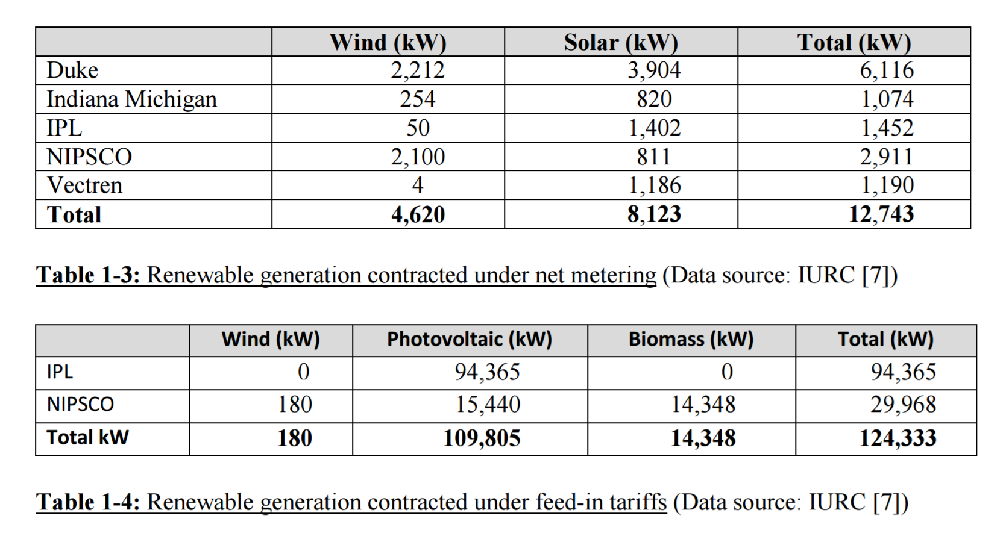
Table 9. Net metering vs. FIT Capacity 2016
What Subsidy???
From Purdue “2016 Renewables Report”

Slide 43
Specific concerns about SEA 309-#1
  Inadequate definition of install (Sec. 13, p. 10, lines 34-36)
  “Update fees and charges” (Sec. 21, p. 13, line 24)
  Although “grandfathering” language does address transference of solar system to another homeowner it does NOT address homeowners who add solar panels to their system and will be required to sign a new Interconnection Agreement
  Will drastically impact Return on Investment (ROI) for solar owners

Slide 44
Specific concerns about SEA 309-#2
Will limit policy mechanisms commonly used to promote solar, such
as power purchase agreements and virtual net metering. In other states, these
are used to expand solar access multiple customer classes. [Chapter 40,
Section 3]
Puts a kill date on net metering of July 1, 2022. We have set the goal
of 1.5% of peak summer load. Let's allow Indiana's solar industry to get there.
[Chapter 40, Section 10 - (2)]
Includes a statutory prohibition of net metering, a simple and fair way
to value excess solar being put onto the grid. Even if utilities want to use net
metering, they cannot under SEA 309. [Chapter 40, Section 11 – (b)(1)]
Systems installed after 2017 will only get grandfathering for
half of its usable life (30 years or more). [Chapter 40, Section 13 – (b)(2)]

Slide 45
Specific concerns about SEA 309-#3
Allows utilities to increase rates on all customers in order to recover cost of credits due to net metering. This will affect low and middle income Hoosiers the most. [Chapter 40, Section 15]
By arbitrarily setting rates for excess solar generation, the bill denies the
benefit and transparency of a study at the Indiana Utility Regulatory
Commission, a prudent next step done in about a dozen other states.
[Chapter 40, Section 17]
Allows utilities to increase monthly service charge for solar
customers to be connected to the grid, changing the rules for a small portion of
their customers. [Chapter 40, Section 19]
Ends the conversation about net metering and solar in Indiana. This bill is a job killer, limiting customer choice, and stifling entrepreneurship in the long term. It is a step backward, not forward, in solar policy in Indiana.

Slide 46
False narrative about energy storage and net metering
SB 309 House sponsor and House Utilities Chair Rep. Dave Ober (R-Albion) stated during the floor debate:
  “Storage is the game changer for DG. But as long as a net metering customer can use the grid as a battery, the market for storage will never develop. I think that is something we need to incentivize. I think SB 309 is decent policy.”
Walker Wright, VP Policy, Green Charge:
  The pathway or bridge to helping energy storage is two-fold: 1) Demand charges; and Higher energy costs
  Residential energy storage will continue to need net metering.

Slide 47
Maryland passes tax credit for residential & commercial energy storage
  Maryland Passes First-of-a-Kind Tax Credit for Residential and Commercial Storage
    The measure provides for a 30 percent tax credit on the installed cost of a storage system, capped at $5,000 for residential and $75,000 for commercial projects. The total credits awarded cannot exceed $750,000 in a year, and the program will run from 2018 through 2022.

Slide 48
Electric utilities are buying solar installation companies
                Duke Energy Renewables buys REC Solar
Marc Manly, who runs Duke Energy's unregulated operations, says Duke Energy Renewables sees rooftop solar for commercial companies as a growth market it can tap into now and ride up to greater scale and profits.
That is at least part of the thinking behind the Duke Renewables' purchase of a majority share of California-based REC Solar, which has developed about 140 megawatts worth of solar capacity in 440 projects nationwide.
  AES Plans to Buy sPower, a Top Utility-Scale Solar Developer.
This morning, AES unveiled plans to acquire sPower, the 10th-largest solar developer in the U.S., for $853 million in cash. AES will buy sPower from the private equity firm Fir Tree Partners. [sPower is a former IndianaDG business member with 4 NIPSCO FIT projects in northern Indiana.]
Once completed, the acquisition will give AES an additional 1,274 megawatts of utility-scale solar power plants, a portfolio of 10,000 megawatts of projects in various stages, and a world class solar development team.

Slide 49
Is net metering a subsidy, incentive or net benefit to other customers? #1
Rooftop Solar: Net Metering is a Net Benefit - Brookings, 2016
Shining Rewards: The Value of Rooftop Solar Power for Consumers and Society - Environment America & Frontier Group, 2015

Slide 50
Is net metering a subsidy, incentive or net benefit to other customers? #2
A Regulator's Guidebook: Calculating the Benefits and Costs of Distributed Solar Generation - IREC, 2013 authors Jason B. Keyes, Partner, Keyes, Fox & Wiedman, LLP and Karl R. Rábago, Principal, Rábago Energy LLC.
A Review of Solar PV Benefit & Cost Studies - RMI, 2013

Slide 51
Who supports solar, renewable energy and customer owned and operated DG?
  Post election National Clean Energy Survey conducted Nov. 10-13, 2016 by Public Opinion Strategies, a Republican polling firm.
  Almost 60% of voters strongly support taking action to accelerate the development and use of clean energy.
    Base GOP (21%): 72% Total Support vs. 24% Total Oppose
    Soft GOP (18%): 82% Total Support vs. 14% Total Oppose
    Independent (16%): 80% Total Support vs. 15% Total Oppose
    Soft Dem (18%): 96% Total Support vs. 2 % Total Oppose
    Base Dem (26%: 96% Total Support vs. 2 % Total Oppose

Slide 52

Duke Energy Indiana Solar PV 20 MWs
PPA’s done by IndianaDG members
Duke Energy Indiana Edwardsport Air Permitting Settlement 8/28/13
All 20 MWs of solar farm projects were done by IndianaDG members Inovateus Solar and Cypress Creek Renewables.

Slide 53
Importance of Net metering to 3rd party solar PV PPA’s
An effective net metering policy is critical to opening the Indiana energy market to competition from renewable energy resources.
Indiana’s net metering policy should be amended to permit 3rd party solar PV Purchase Power Agreements (PPAs)
Notes:
See PowerPoint on Solar PV Third party PPA’s

Slide 54
Status of 3rd-Party Solar PV
Power Purchase Agreements (PPAs) in U.S.
DSIREUSA.org website shows the status of 3rd-Party Solar PV Purchase Power Agreements (PPAs) across the United States.
They indicate the status of 3rd-party PPAs in Indiana is unclear or uncertain.

Slide 55







3rd-Party Solar PV Power Purchase Agreements (PPAs).
www.dsireusa.org / February 2013.
At Least 22 states,
+ Washington DC and Puerto Rico,Authorize or Allow 3rd-Party Solar PV Purchase Power Agreements.
Note: This map is intended to serve as an unofficial guide; it does not constitute legal advice. Seek qualified legal expertise before making binding
financial decisions related to a 3rd-party PPA. See following slides for additional important information and authority references.

Slide 56
Contact information
Laura Ann Arnold, President
  Indiana Distributed Energy Alliance
  545 E. Eleventh Street
  Indianapolis, IN 46202
  (317) 635-1701
  (317) 502-5123 cell
  Laura.Arnold@IndianaDG.net or
  Laura.Arnold@thearnoldgroup.biz

