Slide 1


Fixing the HOA Solar Panel Problem in Indiana
Presenter: Joey Myles
Indianapolis, IN

Slide 2


Table of Contents
Homeowner Stories and Experiences with HOA
Two Types of HOA Restrictions and Extent of Problem
Senate Bill 500 (SB 500) from 2017 Session of Indiana General Assembly (IGA)
Why This Legislation is Important for Indiana
Contact Information and How to Join Campaign
Questions for Audience and Next Steps

Slide 3

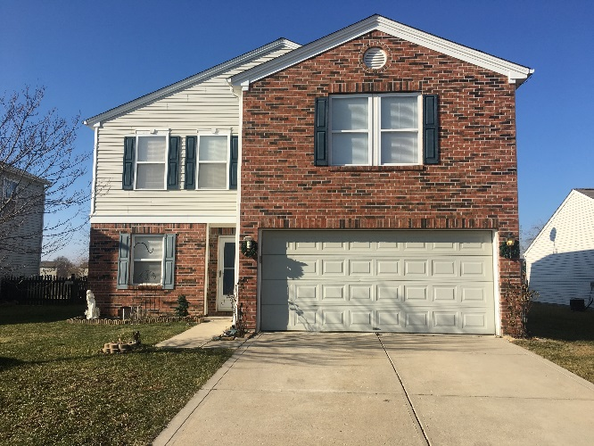
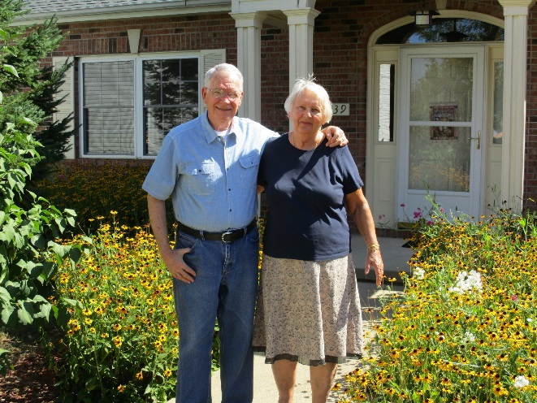
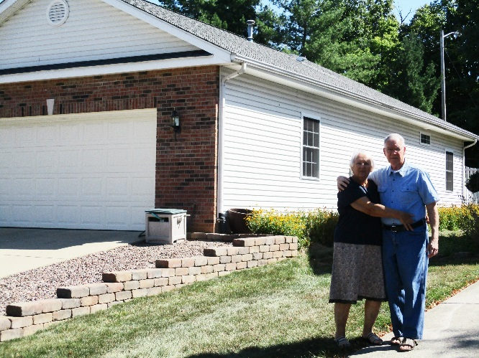
Homeowner Stories
Dustin Holt
  Homeowner in Franklin Township, Indianapolis
  Wanted to install solar panels but HOA has a total prohibition on solar
Gary Wiggins
  Homeowner in Bloomington
  Also faced a total solar prohibition with his HOA
  Elected to his HOA Board and is trying to get covenants changed
Dustin Holt
Dustin’s home
Gary Wiggins and his wife in front of their home

Slide 4

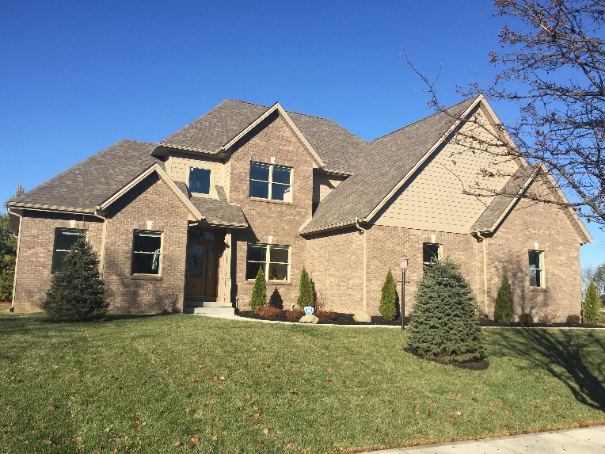
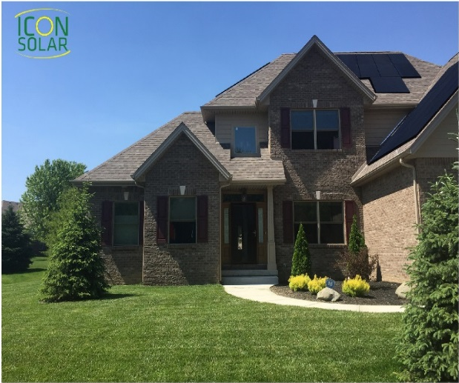
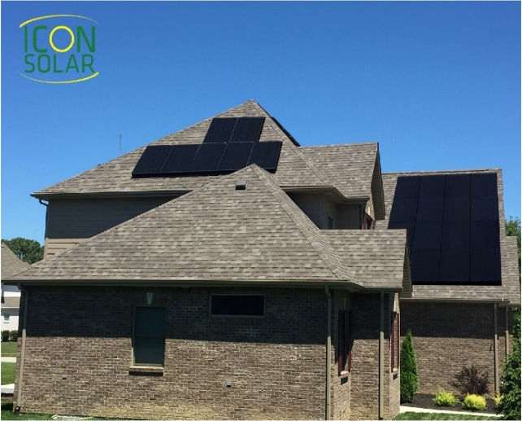
Homeowner Stories (cont’d)
Joey Myles
  Homeowner in Franklin Township, Indianapolis
  HOA covenants allow solar panels but require approval from Architectural Control Committee (ACC), which is part of HOA Board
  First homeowner in neighborhood to ask to install solar panels
  HOA Board opposed street-facing panels (south in my case), citing perceived aesthetics; approved north panel installation
  Neighbors are overwhelmingly supportive
  Optimal orientation (south and west) would produce 52% more energy
Joey Myles with
his wife Sarah
Joey and Sarah’s home (south-facing)
Drawings of optimal installation on Joey and Sarah’s home

Slide 5
The Two Types of HOA Restrictions on Solar
Total and Absolute Prohibition
  Many HOAs will not allow solar panel systems whatsoever (Dustin and Gary examples)
Unreasonable Restrictions by HOA Architectural Review Committees
  No specific, objective criteria
    Example: Joey’s HOA covenants contain only 1 vague sentence on solar panels - “Solar panel installation shall be allowed only when the location, type, and size have been approved by the Committee.”
  Roof prohibitions and demands on keeping solar panels “out of view”
Both restrictions are rooted in the same themes: concern over property values and aesthetics, even though studies have shown that solar panels increase property values and that people who see solar will then want to GO solar.

Slide 6
Extent of HOA Solar Panel Problem in Central Indiana
(analysis as of 02/02/2017)
County | Subject to Architectural Review Committee | Absolute Prohibition | Roof Prohibition (full or partial) | Total
Marion | 51 | 34 | 64 | 149
Hamilton | 40 | 51 | 20 | 111
Hendricks | 12 | 24 | 18 | 54
Johnson | 30 | 10 | 6 | 46
Hancock | 2 | 5 | 1 | 8
Boone | 0 | 3 | 4 | 7
Morgan | 3 | 2 | 0 | 5
Shelby | 0 | 1 | 0 | 1
Total | 138 | 130 | 113 | 381

Slide 7







Senate Bill (SB) 500 from 2017 Session of Indiana General Assembly (IGA)
Sen. Freeman Sen. Kruse Sen. Becker
Authors | Sen. Aaron Freeman (R-Indianapolis) Sen. Dennis Kruse (R-Auburn) Sen. Vaneta Becker (R-Evansville)
Co-Authors | Sen. Mike Delph (R-Carmel) Sen. Greg Taylor (D-Indianapolis)
House Sponsor | Rep. Mike Speedy (R-Indianapolis)
Sen. Delph Sen. Taylor Rep. Speedy
6 outstanding state legislators!
Based off existing Texas law
  Similar laws also exist in California, Colorado, New York, and Oregon

Slide 8
SB 500 from 2017 Session of IGA (cont’d)
SB 500 stated HOAs cannot prohibit or restrict installation of solar energy devices, except in certain cases, which included:
    being located on property owned or maintained by the HOA;
    being located on your roof in an area not approved by the HOA, unless the approved location significantly increases cost or significantly decreases efficiency,
    being located in a fenced yard or patio, when taller than the fence line;
    interfering with use and enjoyment of land by causing unreasonable discomfort or annoyance to a reasonable person
The full text of SB 500 can be found at https://iga.in.gov/static-documents/5/2/9/b/529b7684/SB0500.04.ENGS.pdf

Slide 9
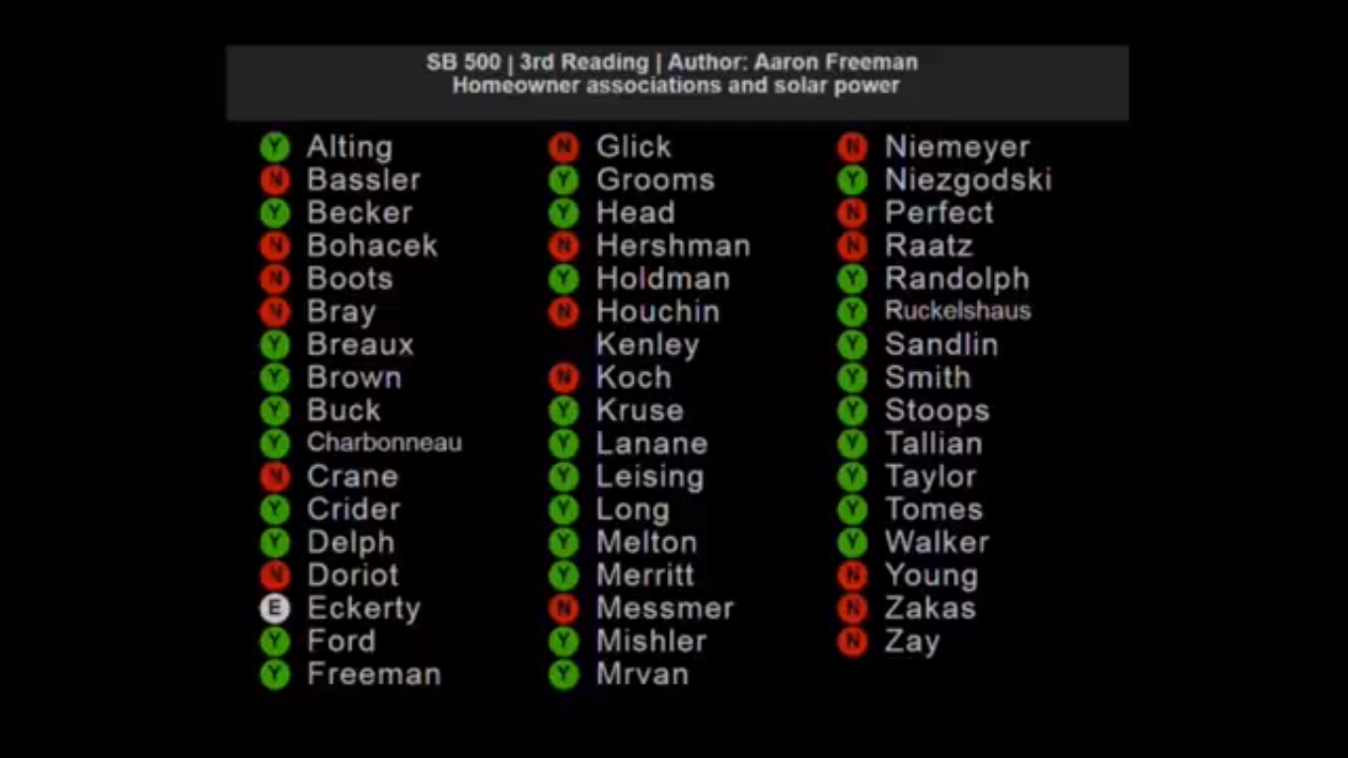
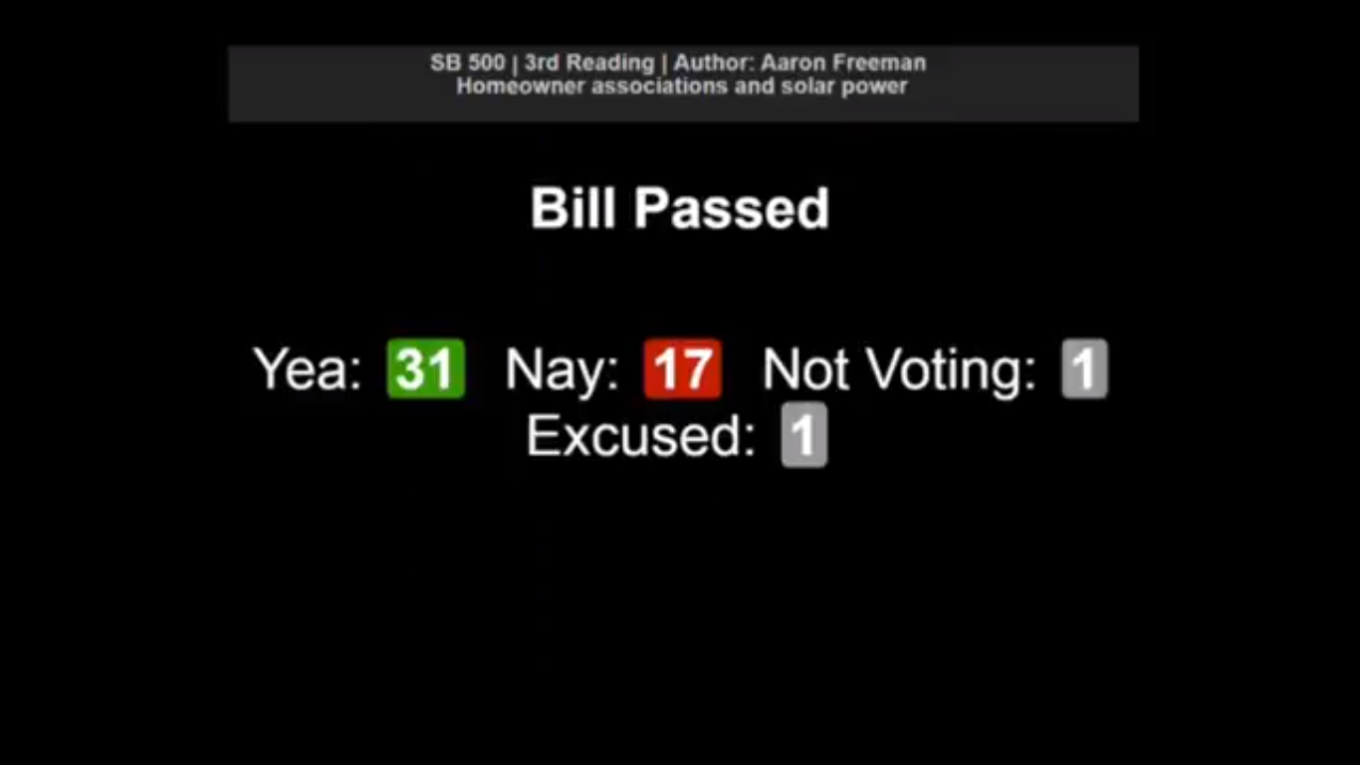
Result of SB 500 in the Indiana Senate
Passed 5-2 out of the Senate Civil Law Committee on January 17, 2017
Passed 31-17 out of the full Indiana Senate on February 16, 2017 (vote tally below). If your Indiana State Senator voted for SB 500, please say “thank you” and ask for their support again in 2018. If they voted against SB 500, please talk with them and let’s see if we can change their mind.

Slide 10
SB 500 Stalled in the Indiana House
After passing the full Indiana Senate, SB 500 did not receive a hearing in the Indiana House Judiciary Committee so it did not advance.
The members of the Indiana House Judiciary Committee are:
Committee Chair: Rep. Greg Steuerwald (R-Danville) Committee Vice Chair: Rep. Wendy McNamara (R-Evansville)
Rep. Woody Burton (R-Whiteland) Rep. Karen Engleman (R-Georgetown) Rep. Dan Leonard (R-Huntington) Rep. Chris May (R-Bedford) | Rep. Jerry Torr (R-Carmel) Rep. Tom Washburne (R-Evansville) Rep. John Young (R-Franklin)
Ranking Minority Member: Rep. Pat Bauer (D-South Bend)
Rep. Ed Delaney (D-Indianapolis) Rep. Ryan Dvorak (D-South Bend) | Rep. Ryan Hatfield (D-Evansville)
Sen. Aaron Freeman has offered to re-introduce the bill in the Senate in January 2018. As of September 2017, we are deciding whether it is best to have the bill introduced in the Senate, House, or both chambers at the same time.

Slide 11
Why This Legislation is Important for Indiana
Energy freedom and choice; less reliance on the grid
The ability to take personal responsibility for one’s own energy future
Economically:
  Purchasing a solar energy system allows you to hedge future increases in electric utility costs
  Filing the solar panel property tax exemption prevents your solar panels from increasing your assessed value
Provides a check and balance on power of HOAs

Slide 12

Contact Information and How to Join the Campaign
Joey Myles
jackbauer3487@yahoo.com
(317) 341-5021
Laura Arnold, President
Indiana Distributed Energy Alliance (IndianaDG)
laura.arnold@indianadg.net
(317) 635-1701
To join the campaign, please visit http://www.indianadg.net/join-indianadg/ or contact Laura Arnold.

Slide 13

Questions for Audience
Do you want to install solar but your HOA has a solar prohibition?
    Follow our step-by-step guide for determining your HOA’s restriction:
    http://www.indianadg.net/find-your-hoa-solar-restrictions/
Do you know someone else having this problem?
You don’t live in an HOA but you are supportive of this common sense change?
If the answer is “yes” to any of the above questions,
we need your help in this campaign.
Next Steps
Join IndianaDG today
Contact your State Representative and Senator, tell them you support removing HOA restrictions on solar in Indiana, and most importantly – you want them to join as a co-author to the bill once it is re-introduced in January during the 2018 session
TO HELP US REMOVE HOA RESTRICTIONS ON SOLAR!

