Slide 1
Community Solar Pilot Project ⸻ ⸺ Stakeholder Proposal
[Alphabetical List of Stakeholders]

Slide 2
Background

Slide 3
Vision for Community Solar
Final Order, IURC Cause No. 45029*:
“[C]ommunity solar can expand access to the direct bill-reduction benefits of distributed solar to lower-income households or customers who otherwise cannot install solar systems on their own property. . .” – Page 23
“[T]his is especially important considering the large percentage of IPL' s customers who lease, rent, and reside in apartment buildings, condominiums, or other shared living arrangements in which they lack the ability or authority to install solar directly on the property.” – Id.

Slide 4
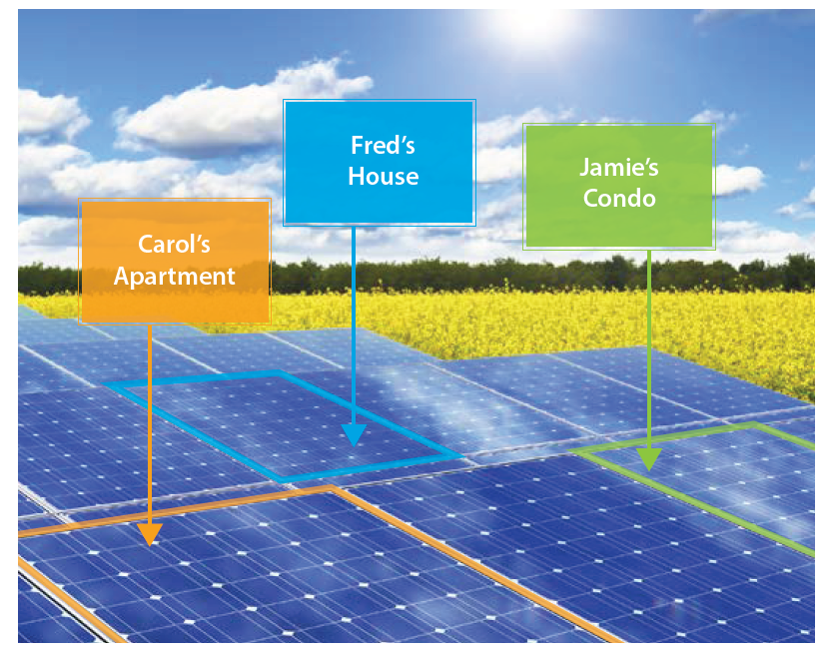
Definition of Community Solar
From IPL’s April 2017 Small Commercial Survey:
“Community solar programs allow several energy customers to share the benefits from one solar site. . .” – Page 1
Image credit: Jason Coughlin, Jennifer Grove, Linda Irvine, Jacobs, Sarah Johnson Phillips,
Leslie Moynihan, Joseph Weidman, "A Guide to Community Solar," National Renewable Energy
Laboratory, 2010.

Slide 5
Stakeholder Interests
Want to expand the economic and environmental benefits of renewable energy access.
Provide a pathway for additional private renewable energy investment and the associated economic development as the program grows.
Provide meaningful, verifiable savings for utility customers from day-one of program participation.
See IPL contribute to the success of the Indianapolis Thrive Plan. (See Thrive Plan EN:1C)

Slide 6
Public Interest Factors to Consider
Economic Benefit – Savings should be made available to participants through their participation in the program.
No Unfair Advantage - Fair competition drives down costs for customers/ratepayers, so utility distributed generation should not undermine competitive distributed generation markets.
This pilot project should not be structured in such a way as to give IPL a competitive advantage over other private businesses and investors in the distributed generation solar market.
If IPL does leverage monopoly power or resources, it should be focused on markets that are underserved by the private market, such as low-income customers.
Valuable New Information – As a pilot project, this community solar program should provide the public with new, substantive insights on the community solar market—including insights on the underserved low-income customer class.

Slide 7
Public Interest Factors Continued
Environmental Justice – This pilot can help to redress the environmental harms suffered by communities that are or have been sited near fossil fuel generation plants.
Transparency - Full and transparent information in all aspects of program development, rollout, and operation is critical for the pilot program’s usefulness for future learning.
Increase access to solar - The pilot program will expand access to solar energy to people currently shut out of the market for any reason.
Reduced energy burden - By providing meaningful, verifiable savings from day-one of program participation, the pilot program will lower electric bills for communities that are disproportionately burdened by energy costs.

Slide 8
Proposal

Slide 9
Project Elements
Subscription
Program Format: 2 options
Subscription Limit
Customer Monthly Credit
Program Option 2: Eligible Customers
Customer Participation Limit
Minimum Term
Waitlists and Subscription Transfers
Contract Penalty
Carve-Outs
If IPL Pursues Option 2: Carve-out % Dedicated to Low-Income Customers
Defining Low-Income
Unsubscribed Blocks
Ownership
System Size
Location of Solar Array
MLK Drive
Program Length
REC Treatment
Project Costs
Learnings
Project/Program Evaluation

Slide 10
Subscription
Stakeholders propose a flat rate for this pilot.
Flat rates provide consistency and reliability. Subscribers to the project would not be surprised by a sudden upswing in energy prices. This is especially appealing for those who want to avoid financial risk. Minimizing any kind of uncertainty through a flat rate would therefore be likely to make the product more attractive to low-income customers, expanding the pool of interested subscribers.

Slide 11
Program Format: 2 Options
1) A 100% low-income community solar program
No participation premium
Additional costs (if any) recoverable from IPL rate base
Low Income customers, in particular, would be dissuaded from participation by having to pay an upfront cost. This is reflected in IPL’s 2017 customer survey.
2) A mixed community solar program with a low-income carve-out
Full transparency of costs and pricing are required to ensure any fee is reasonable
Costs recoverable from IPL program subscribers only
:ow-income carve-out created that is premium-free

Slide 12
Subscription Limit
We support a program design that would enable subscribers to select the amount of their average usage, up to 100%, that they would like to offset through their subscription to the project.
For example, community solar proposals from Florida Power & Light (FPL) and Dominion Energy in Virginia (Dominion) have adopted such subscription limits. FPL
“Residential and commercial customers under 500 kW will have the option to subscribe to…an amount that matches 100% of their monthly electricity use.”-Dominion

Slide 13
Customer Monthly Credit
Participants should receive tangible economic benefits on their utility bills, and there should be perpetual rollover of any excess credit to a participant’s next monthly bill.
See IREC’s Model Rules for Shared Renewable Energy Programs at 8-13.
See Louisville Gas & Electric + Kentucky Utilities Company, Maryland, Cooperative Energy Futures (MN),Xcel Energy CO, Walton EMC Solar Coop (GA).

Slide 14
Program Option 2: Eligible Customers
IPL Customers of any class should be able to subscribe into the project.
There are good reasons to allow larger commercial customers to participate in community solar projects as “anchor tenants,” however it is important to pursue a diverse customer subscription base that is inclusive and representative of all of IPL’s customers, whether large or small, or rich or poor.
By allowing customers of any class to participate, IPL can gain deeper insight into how appealing and scalable a potential community solar program could be.
By enhancing access to renewable energy, particularly to low-income communities who have been traditionally left behind, IPL can help to expand the market for renewable energy products.
Outside of providing the data-based benefits identified above, participation by a diverse class of customers can help to lay a foundation for addressing environmental equity issues traditionally faced by low-income communities and communities of color.

Slide 15
Customer Participation Limit
Residential and Low-Income customers should be able to subscribe up to 100% of their average usage to the program to make the program as attractive as possible to these customer classes, which traditionally have had less access to renewable energy.
We suggest that IPL institute additional participation guide rails that prevent larger customers from consuming a large amount of the pilot’s capacity.
For example, in Xcel Energy Colorado’s community solar offering, no single subscriber can be allocated more than 40% of the total garden.

Slide 16
Minimum Term
There should be NO contract length requirement.
For example, community solar proposals from Madison Gas & Electric (MGE) & FPL impose no minimum contract term. MGE
“FPL SolarTogether participants will not be tied to a long-term contractual commitment: once enrolled, participants may terminate or reduce their subscription level at any time.” FPL
If a contract term is imposed, it should not exceed one year. IPL’s own research indicates that customers prefer a 1 year commitment term or less.

Slide 17
Waitlists and Subscription Transfers
Waitlists should be established to maintain steady project subscription.
Given its administrative experience, IPL should manage subscription transfers, which pose some level of administrative burden.
Interested participants may include renters, or others who may need to move on short notice. Some potential subscribers may be hesitant to participate because of an anticipated need to modify or discontinue their participation in the project. Participants should therefore be provided as much flexibility as possible in this regard, allowing for both “portability” and “transferability” of remaining subscription terms.
“Portability” refers to allowing participants to keep their subscription in the project if they move within the project’s service territory.
“Transferability” refers to allowing participants to transfer their subscription in the project to another energy consumer within the project’s service territory if the participant moves outside of said territory.
Examples of portable and transferable subscriptions can be found in Illinois. See also.

Slide 18
Contract Penalty
Participants should be able to leave the program without financial penalty.
For example, community solar programs from FPL and Walton EMC solar coop in Georgia (Walton) impose no such penalty.
“You can discontinue your solar energy commitment at any time by notifying us.”-Walton
“Upon notice to FPL, participants may terminate their participation in the Program at any time for any reason without penalty…However, upon either voluntary or involuntary termination of participation, the customer may not re-enroll in the Program for a 12-month period.”-FPL

Slide 19
Carve-Outs
In order to ensure that project subscriptions are representative of IPL’s customer base, IPL should create carve-outs in the project to serve different customer classes.
Carve-out requirements are a straightforward policy that guarantee a percentage of a program will ultimately serve the various customer segments.
For example, depending on the size of the project, commercial and industrial customers may be limited to 40% of project capacity, allowing residential customers access to the remaining 60% of project capacity.

Slide 20
If IPL Pursues Option 2: Carve-out % Dedicated to Low-Income Customers
Proposal
Notable Carve-Out Programs
Based on other solar project carveouts, Stakeholders propose a 5-20% carve out in this project for low-income customers.
Colorado: Xcel Energy started with a 5% project level carve-out before shifting to a larger program carve-out.
Oregon: There is a 5% carve-out for every project, plus an additional 5% target for the entire program.
Maryland: 30% of a 200 MW pilot program must serve Low- and Moderate- Income customers (LMI), with one-third of that program carve-out (10%) required to serve low-income households.
Connecticut: 20% of a 6 MW pilot program is dedicated to LMI subscriber participation.
New Jersey: "At least 40% of total annual capacity shall be allocated to low- and moderate-income (LMI) projects

Slide 21
Defining Low-Income
To be eligible to participate in the low-income portion of the program, a customer must be one of the following: (1) a LIHEAP participant; (2) LIHEAP qualified; or (3) eligible for Supplemental Nutrition Assistance Program (SNAP), Temporary Assistance for Needy Families (TANF), Healthy Indiana Plan (HIP), or Medicaid.
We do NOT want IPL obtaining salary information from customers.

Slide 22
Unsubscribed Blocks
Typical in other territories for utility to purchase unsubscribed energy
“Unsubscribed energy from the shared array will be purchased from the Subscriber Organization by the utility…”-Maryland
A back-up subscriber (or an anchor tenant acting as a back-up subscriber) who covers unsubscribed blocks may also be appropriate if the option is available. See MN Model
If the program is made attractive enough, there should be no unsubscribed blocks since the utility will be able to access a waiting list for the program. Stakeholders recommend partnering with community organizations to find subscribers, particularly low-income subscribers.
Similar relationship between utilities and community organizations with weatherization programs.

Slide 23
Ownership
We are supportive of IPL owning the initial pilot project.
As this program grows, subsequent projects should be developed and owned by third parties to increase competition and produce more market information.
If subscribers are expected to pay the full costs of project development, then they should be entitled to the full benefits of their participation through the proper valuation of bill credits. (See IREC’s Model Rules for Shared Renewable Energy Programs at 8-13.)

Slide 24
System Size
Stakeholders propose a system size of 3.5 MW for this pilot.
A larger system has the advantage of economies of scale.
Savings can be passed on to participants.
MGE’s 500 KW solar farm proposed in 2016 quickly sold out and they’re now going back to the Commission to ask for a 5 MW installation.
Additional Examples: MGE (6 MW), Cooperative Energy Futures of Minnesota (5.6 MW), Walton EMC Solar Coop of Georgia (6.5 MW), Dominion Energy of Virginia (10 MW).

Slide 25
Location of Solar Array
Mainly, the project should be sited in the most cost-effective location, taking into consideration options such as brownfield sites, IPL land, other available land in Indianapolis
Ensuring least cost implementation promotes customer savings and economic efficiency
In determining the most cost-effective location, consideration should be given to maximizing grid benefits and keeping development and interconnection costs low.
Potential added distribution value of locating the system closer to population centers and higher electricity demand
Social, health, and environmental justice benefits should also be considered in siting, since these are additional values that are of interest to IPL customers.

Slide 26
MLK Drive
In determining the siting for the project, Stakeholders specifically request consideration be given to MLK Drive in order to enhance just energy access.
US EPA Disadvantaged Community
US EPA Superfund Site
TIF Funds
31.9% live below the poverty line in this zip code (46208)

Slide 27
Program Length
The asset life of the program is 25 years. There should not be any limit to the amount of time a customer can receive benefits from the program so long as a customer remains interested in participating in the program.

Slide 28
REC Treatment
Utility distributed generation should meet customer demand for clean energy and help customers to achieve sustainability goals.
Ownership of RECs should stay with participants unless they choose for the utility to retire the RECs on their behalf.
FPL has proposed such a system.
“Participants may elect to have FPL retire on their behalf any renewable energy certificate (“RECs”) associated with their FPL SolarTogether subscription. Participants who elect this option may claim the environmental attributes associated with the REC once it has been retired.”

Slide 29
Project Costs
The project should be competitively bid through a Request for Proposal (RFP) to minimize costs.
For example, Dominion and Xcel Energy Colorado (Xcel) issued public RFPs for their community solar projects. See Xcel Energy’s 2018 Request for Proposals.

Slide 30
Learnings
Pilot projects should not be duplicative; instead they should provide new insights
IPL has not yet identified what it seeks to learn from this pilot project
As designed, does the program offer something that people want to subscribe to?
How does the cost of subscription impact the ability of customers to subscribe?
Is there is a connection of the value of the subscription and reaching low-income subscribers?
Insights from the pilot should be made publicly available

Slide 31
Project/Program Evaluation
Include an annual process for program evaluation, assessment, and adjustment in conjunction with interested stakeholders/members of the public. The annual program evaluation process should include, at minimum:
An assessment of available capacity
The opportunity for additional capacity to meet customer demand
The customer value proposition
The current subscriber mix (including renters)
Subscriber mobility (participant transfer rate)
The effectiveness of marketing, education, and outreach strategies
Initiate regular, transparent customer outreach and engagement about the program and any complementary programs

Slide 32
Questions and Comments

