Slide 1
Indiana 2022 PURPA Avoided Cost Rates 30-day Filings
Laura Ann Arnold, President
Indiana Distributed Energy Alliance
March 3, 2022

Slide 2
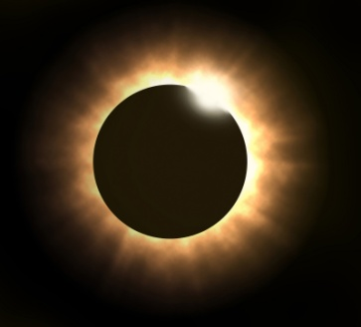
2022 Filed PURPA “Avoided Cost” Rates
Utility | 30 day filing ID | Time Period | Energy rate ($/kWh) | Capacity rate ($/kW/month)
Duke Energy | 50489 | Standard | $0.045106 | $4.73
AES Indiana | 50493 | Peak Period | $0.0302 | $5.83
 |  | Off Peak Period | $0.0277 | $5.83
CenterPoint | 50492 | Annual On-Peak | $0.03990 | $6.08
 |  | Annual Off-Peak | $0.02999 | $6.08
I&M/AEP | 50494 | Standard | $0.0365 | $7.19
 | TOD | On-Peak | $0.0433 | $7.19
 |  | Off-Peak | $0.0316 | $7.19
(see 170 Ind. Admin. Code 4-4.1-10)

Slide 3
2022 Filed PURPA “Avoided Cost” Rates
Utility | 30 day filing ID | Time Period | Energy rate ($/kWh) | Capacity rate ($/kW/month)
NIPSCO | 50491 | Summer (May-Sept)
 | TOU | On-Peak | $0.0476 | $5.74
 |  | Off-Peak | $0.03410 | $5.74
 |  | Winter (Oct-Apr)
 |  | On-Peak | $0.05157 | $5.74
 |  | Off-Peak | $0.04305 | $5.74
 | STD | Summer Period | $0.04123 | $5.74
 |  | Winter Period | $0.04676 | $5.74
(see 170 Ind. Admin. Code 4-4.1-10)

Slide 4
Contact information
Laura Ann Arnold, President
Indiana Distributed Energy Alliance
545 E. Eleventh Street
Indianapolis, IN 46202
(317) 635-1701
(317) 502-5123 cell
Laura.Arnold@IndianaDG.net
Laura.Arnold@thearnoldgroup.biz

