Slide 1

Indiana 2023 PURPA Avoided Cost Rates 30-day Filings
Laura Ann Arnold, President
Indiana Distributed Energy Alliance
March 6, 2023

Slide 2
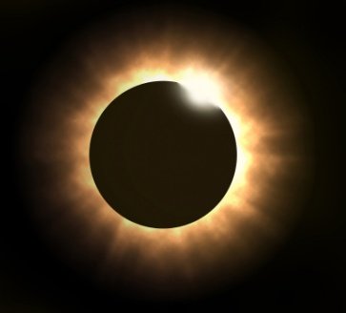
2023 Filed PURPA “Avoided Cost” Rates
Utility | 30 day filing ID | Time Period | Energy rate ($/kWh) | Capacity rate ($/kW/month)
Duke Energy | 50632 | Standard | $0.045464 | $6.47
AES Indiana | 50633 | Peak Period | $0.0377 | $6.39
 |  | Off Peak Period | $0.0330 | $6.39
CenterPoint | 50636 | Annual On-Peak | $0.06497 | $6.33
 |  | Annual Off-Peak | $0.05116 | $6.33
I&M/AEP | 50634 | Standard | $0.0394 | $8.16
 | TOD | On-Peak | $0.0469 | $8.16
 |  | Off-Peak | $0.0340 | $8.16
(see 170 Ind. Admin. Code 4-4.1-10)

Slide 3
2023 Filed PURPA “Avoided Cost” Rates
Utility | 30 day filing ID | Time Period | Energy rate ($/kWh) | Capacity rate ($/kW/month)
NIPSCO | 50635 | Summer (May-Sept)
 | TOU | On-Peak | $0.06073 | $9.10
 |  | Off-Peak | $0.04227 | $9.10
 |  | Winter (Oct-Apr)
 |  | On-Peak | $0.05245 | $9.10
 |  | Off-Peak | $0.04614 | $9.10
 | STD | Summer Period | $0.05192 | $9.10
 |  | Winter Period | $0.04891 | $9.10
(see 170 Ind. Admin. Code 4-4.1-10)

Slide 4
Contact information
Laura Ann Arnold, President
Indiana Distributed Energy Alliance (IndianaDG)
545 E. Eleventh Street
Indianapolis, IN 46202-2627
(317) 635-1701
(317) 502-5123 cell
Laura.Arnold@IndianaDG.net

